Slide 1
Integrating a
Career Pathways
Model
MACAE Conference
October 16-18, 2016

Slide 2
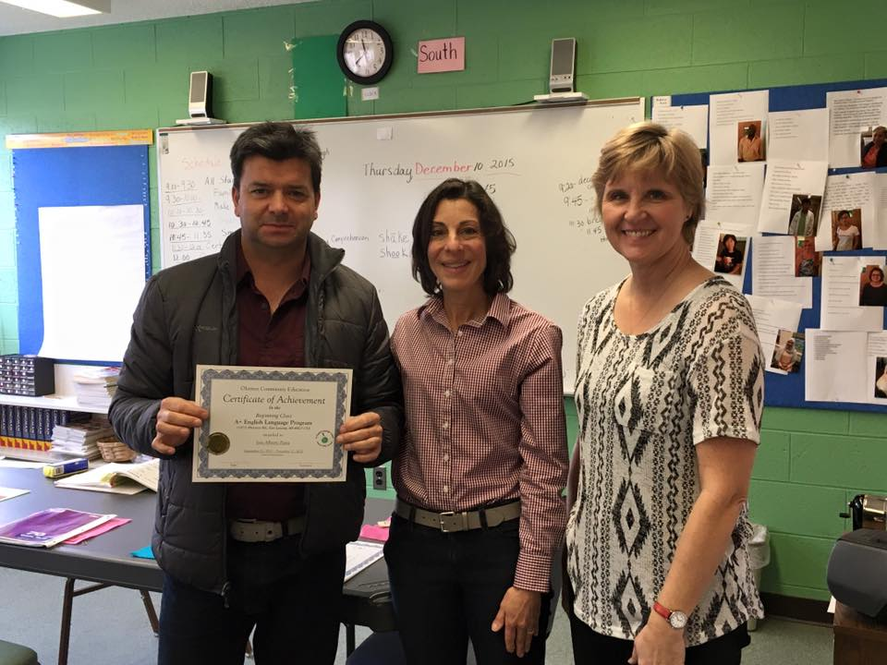
A Story of a student
Name: Jose Parra

Slide 3
WIOA Languages Changes it All!
WIOA Requires us to:
Work with partners-Michigan Works, Michigan Rehabilitation Services, Youth Services &
Colleges/Universities/Technical Schools
Utilize a Career Pathways system
Integrate ESL Civics (IELCE)-Integrated English Literacy and Civics Education

Slide 4
National Data
ESL Information
62% of the Foreign Born residents over the age of 16 are working
16.5% of all foreign born residents over the age of 25 have at least a bachelor’s degree
30% of all foreign born residents over the age of 25 have less than a high school degree.
American Community Survey

Slide 5
Michigan Data
ESL Information
52.5% of the Foreign Born residents over the age of 16 are working
40% of all foreign born residents over the age of 25 have at least a bachelor’s degree
22.5% of all foreign born residents over the age of 25 have less than a high school degree.
American Community Survey

Slide 6
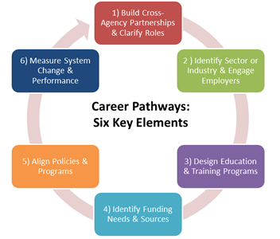
Career Pathways
6 elements

Slide 7
Where are you in your program?
What is your level of understanding?
What is the Level of Understanding: Career Pathways System
What is the level of understanding of your Career Pathways System in your program or region? | Low←--------------------------→High
 | 1 | 2 | 3 | 4 | 5 | 6 | 7 | 8 | 9 | 10
Adult Education Administration
ABE Staff
GED Staff
ESOL Staff
CTE Faculty
Counselors & Advisors
Adult students

Slide 8
What is a Career Pathway?
A New Approach to Program Implementation
True definition of a Career Pathways is a sequence of coursework that:
Aligns with the skill needs of industries in your region
Involves transition into post secondary, apprenticeship or trainings
Utilizes curriculum that is contextual to develop work readiness skills
Incorporates appropriate and integrated instruction to accelerate education
Leads to an attainment of an industry-recognized degree or credential
Helps worker enter or advance in a specific field
Includes academic and career counseling
Meets the needs of the student with help with barriers
Integrates Civics Education (IELCE)
Examples:
I-Best: 2 Pairs of instructors in the same classroom teaching a job
(CNA)-One academic, one technical skills
Alternating Teachers: Same as above but not at the same time
VESL/VABE: Students prepare to work in a specific field or sector specific -Entire Class
Cluster VESL/VABE: Greater variety of students and goals in a class

Slide 9
The Classroom
What does it mean in the classroom?
Intense/streamlined classroom instruction
Development of soft skills need for employment
Sharing a vision and strategies with community partners and within a program
Career Pathway aligns with the Michigan Works/top regional sector industries
Integrate Employability skills
Prepare our students to be successful in post-secondary education
Use contextualized materials
Include Career/Education next-steps

Slide 10
Putting Career Pathways to Work
Reviewing the 6 Key Elements
Assessment of Career Pathways Key Elements 1-3
Partnerships
Sector Identification/Employer Engagement
Program Design and Delivery

Slide 11
Okemos A+ English Language
Program
What are we doing?
Program Strategic Planning (Spring 2016)
Meeting with local industries:
Meijer
Peckham
Sparrow
Cameron Tool and Die Corporation
Looking at Employability Skills/Standards – Kentucky Model to
integrate in classrooms (Fall 2016)
Creating classrooms to help with ESL/employability and soft skills in the workplace - 180 Skills! (January 2017)
Working with HR in the program for interviewing skills
Working with Lansing Community College to create an academic bridge program/shared instruction

Slide 12
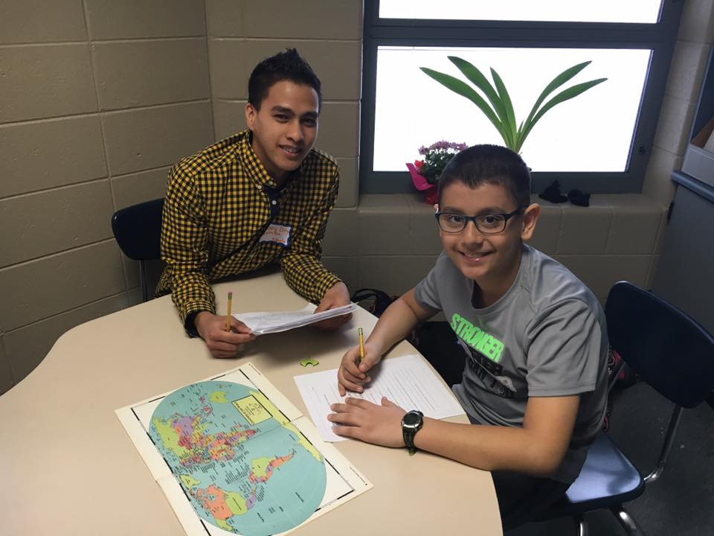
A Story of a student
Name: Danny Boy Quimba

Slide 13
Contact Information
Karyn Goven
Director
Okemos A+ English Language Program
karyngoven@gmail.com
Patrick Brown
Program Specialist
Okemos A+ English Language Program
Patrick.brown@okemosk12.net

