Slide 1
High Quality Credentialing
MACAE Conference
October 18, 2016

Slide 3
What is an industry recognized credential?
Industry recognized credentials are sought or accepted by employers within the industry or sector involved, and are a recognized, preferred, or required credential for recruitment, screening, hiring, retention, or advancement purposes.

Slide 4
Defining Credentials
Under the Workforce Innovation and Opportunity Act (WIOA), the term “Recognized Postsecondary Credential” means a credential consisting of
a certificate of completion of an apprenticeship;
a license recognized by the state involved or Federal Government; or
an associate or baccalaureate degree.
an industry-recognized certificate or certification;

Slide 5
Credential Criteria
1. Industry-Recognized | 2. Portable | 3. Third Party Validated/Accredited | 4. Stackable
Either created or endorsed by industry, a nationally-recognized industry association or organization that represents a large portion of the industry with clear preference among local employers and regional training programs. A credential that is sought or accepted by companies within the industry for hiring or recruitment. | Recognized and accepted in settings other than in which it was earned: In other geographic locations At other educational institutions By other industries By other companies Recognized broadly (not only locally), among both employers and educational institutions, for the purposes of further education leading to additional advanced certificates. | Credentials are held to a higher standard of quality when they are accredited, for much the same reasons that the federal government requires third-party accreditation of colleges to be financial aid eligible. | A credential that is a part of a sequence of credentials that can be accumulated over time to build an individual’s qualifications and help them move along a career path to different and potentially higher-paying jobs. In the most basic sense, this refers to the career pathways concept that credentials should be linked, with lower-level content stacking to upper-level content, allowing an individual to earn further education and progress to higher paying jobs over time.

Slide 7
Ask Yourself
Is the program comprised of more than one course?
Program descriptions in college or training provider catalogues
Occupational licensing and certification requirements by the certifying agency

Slide 8
Ask Yourself
Lesson plan(s) and curriculum
Class syllabus
Prerequisites - i.e., the program is completed through a series of training activities that build upon each other to expand the student's breadth and depth of knowledge and skills.
Evidence based on lesson plans, curricula, etc. that instructors typically teach the course in the same sequence, according to the same schedule, each time the course is offered.
Does the training program have a clear structure and standardized mechanism of delivery?

Slide 9
Ask Yourself
Job qualifications or pre-requisites (e.g., licensure, certification or any other evidence the prospective employee must provide as evidence of competency in order to be hired).
Once all training and testing is completed, what does the student obtain for his/her effort? (e.g., license to practice, certificates of competency, eligibility for higher levels of training and education).
The individual can perform the work required by the occupation without additional training immediately after hiring. For example, an emergency medical technician (EMT) can perform Cardiopulmonary Resuscitation (CPR) on a patient at the time of hiring by an ambulance service.
Does the program fulfill a specific set of occupational requirements with clear and measurable goals and objectives?
Will the credential holder be able to function effectively on the first day on the job/early in employment with minimal supervision?

Slide 10
Ask Yourself
Employer hiring standards within the industry.
Evidence of reciprocity across state or regional borders (i.e., no further training is required to secure the same job in another location, or minimal training requirements to account for regulatory differences associated with State licensing and certification laws/regulations.)
Are the skills truly transferrable?

Slide 11
Ask Yourself
Eligibility requirements for certificates, licenses or credentials.
Continuing education requirements to renew certificates, licenses or credentials.
Length of time a certificate, license or credential is valid.
Recertification requirements after a certificate, license or credential has expired.
Employer requirements for maintaining current certification, licensure or credentials.
Employer prerequisites to employment that state a preference for applicants with the certificate/credential.
Is there evidence that the program provider will not award the credential should the participant fail to meet required standards?

Slide 12
Ask Yourself
A written test must be passed to qualify for a license, certificate or credential.
A practical skills test (if applicable) must be passed to qualify for a license, certificate or credential.
The training program and courses have clearly stated pass-fail criteria that apply to all students.
How is successful program completion determined?

Slide 13
Ask Yourself
Who issues the certificate or license?
Is the issuing party listed in Training and Employment Guidance Letter (TEGL) 15-10?

Slide 14
Issuing Parties
A state educational agency or a state agency responsible for administering vocational and technical education within a state.
An institution of higher education described in Section 102 of the Higher Education Act that is qualified to participate in the student financial assistance programs authorized by Title IV of that Act. This includes community colleges, proprietary schools, and all other institutions of higher education that are eligible to participate in federal student financial aid programs.
A professional, industry, or employer organization (e.g., National Institute for Automotive Service Excellence certification, or a National Institute for Metalworking Skills, Inc. Machining Level I credential) or a product manufacturer or developer (e.g., Microsoft Certified Database Administrator, Certified Novell Engineer, or a Sun Certified Java Programmer) using a valid and reliable assessment of an individual’s knowledge, skills and abilities.
Employment and Training Administration’s Office of Apprenticeship or a State Apprenticeship Agency.
A public regulatory agency, upon an individual’s fulfillment of educational, work experience or skill requirements that are legally necessary for an individual to use an occupational or professional title or to practice an occupation or profession (e.g., Federal Aviation Administration aviation mechanic license or a state licensed asbestos inspector).
A program that has been approved by the Department of Veterans Affairs to offer education benefits to veterans and other eligible persons.
Job Corps centers that issue certificates.
An institution of higher education which is formally controlled, or has been formally sanctioned or chartered, by the governing body of an Indian tribe or tribes.
Organizations and institutions that award industry-recognized credentials include:

Slide 15
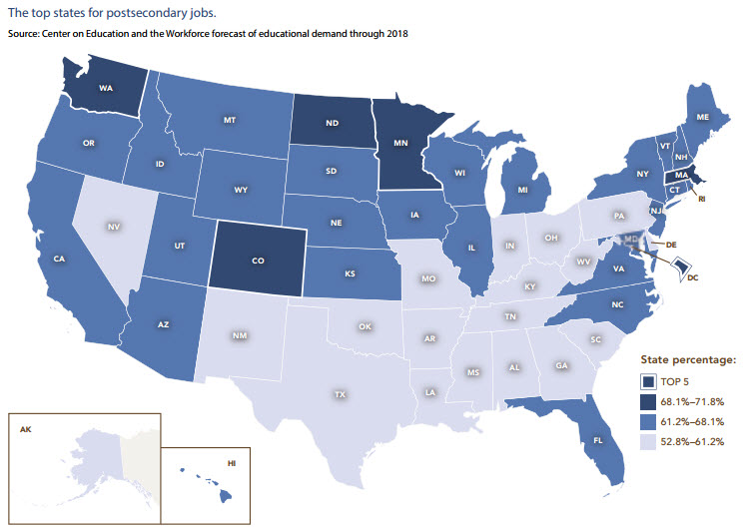
Why Credentials Matter
By 2018, over two-thirds of American jobs will require some post-secondary education or training, with nearly one-third of all jobs available to those with an associate’s degree.
Which states will lead the nation in job openings requiring postsecondary education?

Slide 16
Why Credentials Matter
Jobs requiring post-secondary education pay a significant premium over many jobs open to those with just a high school degree.

Slide 17
Begin challenging your own assumptions. Your assumptions are your windows on the world. Scrub them off every once in while, or the light won't come in. –Alan Alda
Colleges and universities represent only 35 percent of the entire postsecondary education and training system.
The rest consists of on-the-job training, formal employer-provided education programs, military training, apprenticeships, and a variety of other programs.
https://cew.georgetown.edu/wp-content/uploads/2014/12/fullreport.pdf

Slide 18
National Dialogue
Growing Number & Type of Labor Market Credentials:
- Degrees - Diplomas
- Certifications - Licenses
- Apprenticeships
Growing Uncertainty About Meaning, Content, Quality, Value:
- Competency/Credit Hour
- Prior Learning
- Multiple Schools
- Application/Academic
- On-line
- Industry Recognized
Lack of Common Language for Describing/Comparing Credentials Confuses:
- Employers - Educators
- Students - Job Seekers
- Regulators - Certifiers
Misalignment & Inefficiencies:
- Misalignment of what industry says they
need, what educational opportunity
/training produces (outcomes), and what
the industrial credentialing organizations
test

Slide 19
What is badging?
Digital badges are a validated indicator of accomplishment, skill, quality or interest that can be earned in various learning environments. We have yet to review a badge, or series of badges, that results in a credential meeting the criteria found in TEGL 15-10.

Slide 20
State and Local Dialogue Download Here

Slide 21
Fast Facts
Click here to give it a try

Slide 22
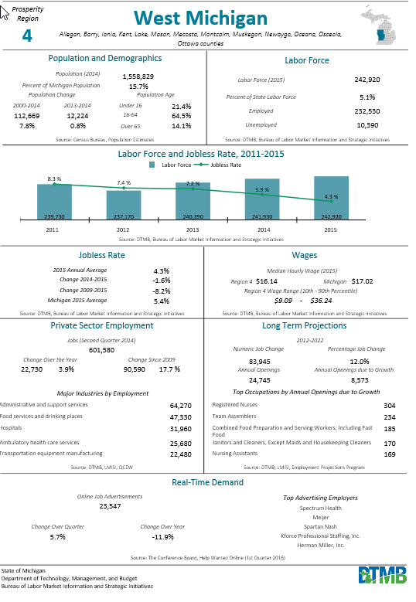
Highlight:
Regional
Fast Facts

Slide 23
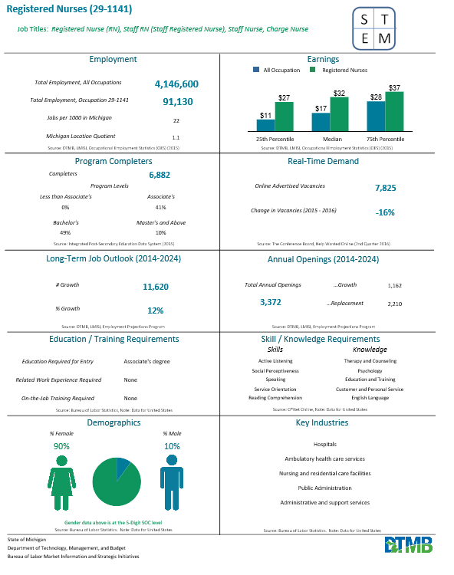
Highlight: Occupation Fast Facts

Slide 24
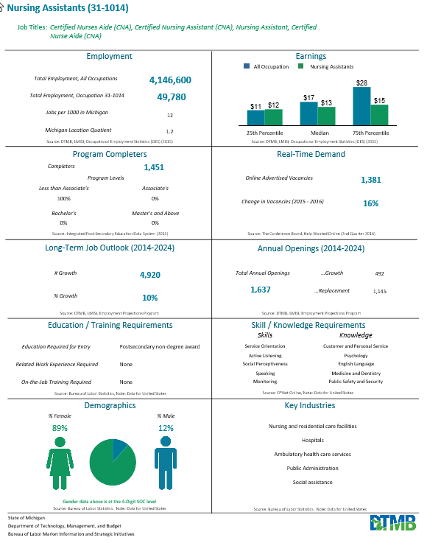
Career Path Option

Slide 25
Is the occupation suitable for the participant?

Slide 26
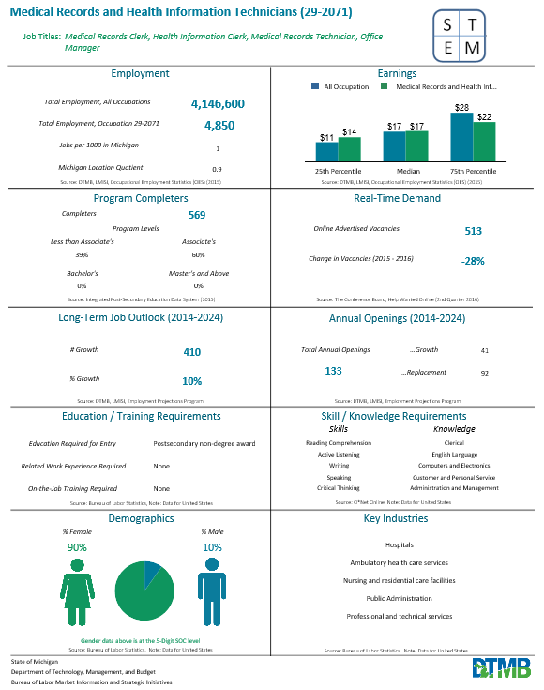
Plan B

Slide 28
There is always a way to turn a problem into an opportunity.
Find it. –Josh Linker

Slide 29
Best Practice: Michigan Works! Agency in partnership with Mid-Michigan Community College and Montcalm Community College View the web page here.

Slide 30
Best Practice Continued

Slide 31
Rapid Response Recruitment Flyer

Slide 32
Best Practice: Great Lakes Bay in partnership with Delta College Visit the webpage here.

Slide 33
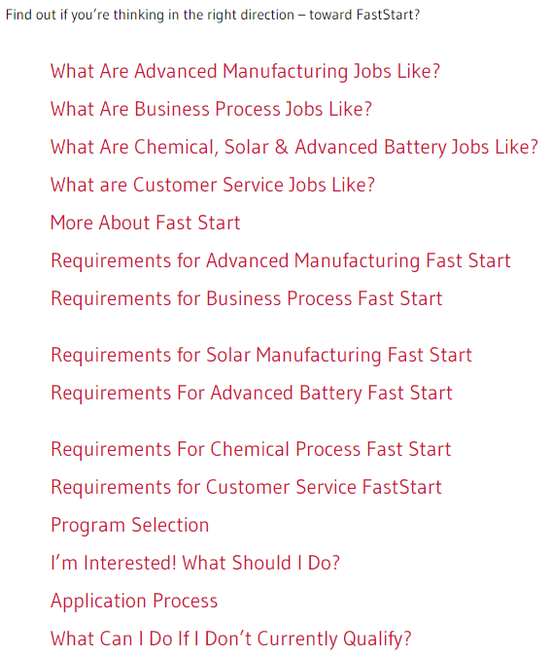

Slide 34
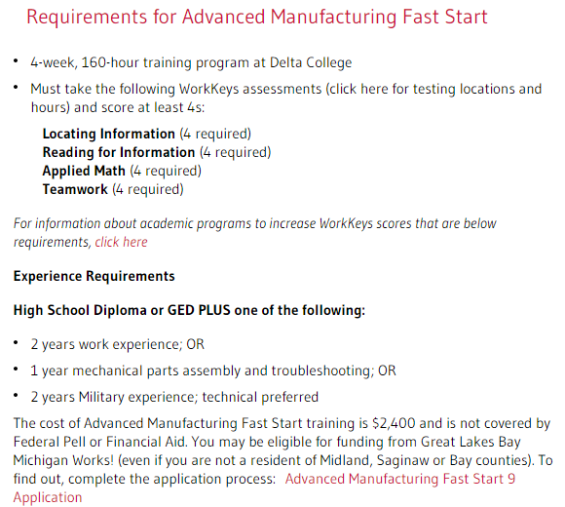

Slide 35
Fast Start Application

Slide 36
Fast Start Application Continued

Slide 37
Fast Start Results: October 20th, 2008 through August 24, 2015
Fast Start Program |  | Trained |  | Completed |  | Credential Rate |  | Employed |  | EER
Chemical Process Technology |  | 215 |  | 209 |  | 97.2% |  | 195 |  | 90.7%
Advanced Manufacturing |  | 132 |  | 127 |  | 96.2% |  | 97 |  | 73.5%
Advanced Battery Manuf. |  | 165 |  | 162 |  | 98.2% |  | 128 |  | 77.6%
Solar Manufacturing |  | 138 |  | 135 |  | 97.8% |  | 128 |  | 92.8%
Business Process Services |  | 31 |  | 31 |  | 100.0% |  | 28 |  | 90.3%
Total Fast Starts |  | 681 |  | 664 |  | 97.5% |  | 576 |  | 84.6%

Slide 38
Who are we missing?

Slide 39
Veterans
Priority of Service
Discharged may mean Dislocated Worker
Category: Has been terminated or laid off or has received a notice of termination or lay-off from employment; TEGL 22-04 states that a discharge from the military under honorable circumstances meets this “termination” criterion. (Discharge from active duty does not necessarily mean retirement, but rather may mean recently returned from an active deployment or other.)
Joint Service Transcripts (JSTs)
* Download at https://jst.doded.mil/official.html

Slide 40
The JST is an official transcript tool that validates and documents professional military education, training, and occupational experience of service members and veterans.
JSTs include military schooling and work history.
Transcripts are certified by American Council on Education, who specializes in translating military training into college credit.
Free online viewing and ordering service.
Notes:
Michigan Department of Corrections accepts Joint Services Transcripts to meet the 15 credit minimum required to enter the academy.

Slide 41
Who is asking veterans for JSTs?

Slide 42
Michigan Legislation
Public Act 483 of 2014 (Effective 4/13/2015)
Sec. 123b.
(1) The board of trustees shall ensure that the community college does all of the following in its admission application process if it knows that an applicant for admission is currently serving, or has ever served, as a member of the military, the national guard, or the military reserves:
(a) Inform the applicant that he or she may receive academic credit for college-level training and education he or she received while serving in the military.
(b) Inform the applicant that he or she may submit a transcript of his or her college-level military training and education to the community college.
(c) If the applicant submits a transcript described in subdivision (b), evaluate that transcript and notify the applicant of what transfer credits are available to the applicant from the community college for his or her college-level military training and education.
(2) As used in this section, "transcript" includes a joint services transcript prepared for the applicant under the American council on education registry of credit recommendations.
Public Act No. 44 of 2015 (Effective 9/7/2015)
Sec. 275b.
(1) Each public university receiving funds under section 236 shall ensure that the public university does all of the following in its admission application process if it knows that an applicant for admission is currently serving, or has ever served, as a member of the military, the national guard, or the military reserves:
(a) Inform the applicant that he or she may receive academic credit for college-level training and education he or she received while serving in the military.
(b) Inform the applicant that he or she may submit a transcript of his or her college-level military training and education to the public university.
(c) If the applicant submits a transcript described in subdivision (b), evaluate that transcript and notify the applicant of what transfer credits are available to the applicant from the public university for his or her college-level military training and education.
(2) As used in this section, “transcript” includes a joint services transcript prepared for the applicant under the American council on education registry of credit recommendations.

Slide 43
Military Medic to Paramedic
Launched in January, 2012 by Lansing Community College
Paramedic and nursing employment is currently strong, with projected demand for the next decade.
Students in the program are eligible for GI-bill funds, Military Tuition Assistance (TA) and traditional Title IV financial aid.
General Program Information
The program is comprised of two stages:
Military Medic and Advanced EMT to Paramedic
Paramedic to Registered Nurse (Advanced Standing RN Program)
Students who complete the first stage will be prepared to take the
national paramedic licensing exam. After the second stage a graduate
will be prepared to take the national RN nursing licensing exam.
Military Medic to Paramedic Program
28 weeks to complete (Traditional program 11-12 months)
Student awarded credit for previous military education and experience
Paramedic to Nurse Program
Advanced Standing Track takes three semesters to complete (Traditional program 2 years)
Student awarded credit for paramedic education
View the webpage here.
Notes:
in January, 2012, Lansing Community College launched an education program specifically designed for military medics and advanced EMT's. The goal was to create a pathway for military medics and Advanced EMT's to transition to paramedics. Those who complete this program are positioned to continue onward to become a nurse, if desired, by entering into the Advanced Standing Nursing Program. Paramedics earn a median salary over $32,000, with nurses earning a median salary over $63,000.

Slide 44
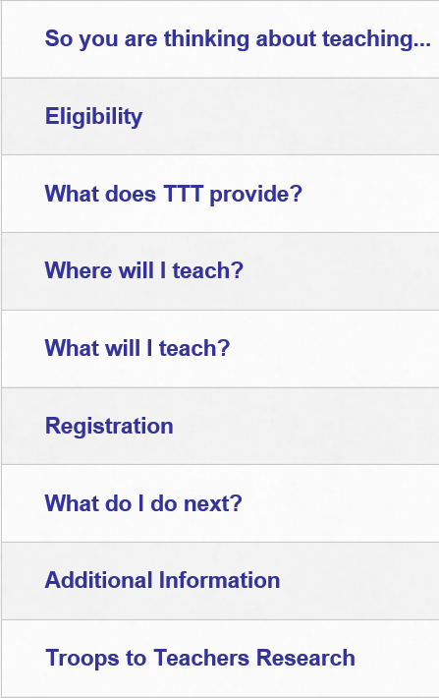
View the webpage here.

Slide 45
Frequently Asked Questions

Slide 46
Frequently Asked Questions
Q: May the National Career Readiness Certificate (NCRC) be reported as a credential?
A: No. Following the Michigan 2015 consolidated review, conducted by USDOL, a finding stated the following:
Training and Employment Guidance Letter 15-10 states work readiness certificates and Workforce Development Board issued certificates are not recognized as credentials. The ETA considers the National Career Readiness Certificate (NCRC) to be work readiness and therefore cannot be counted as a credential. The State must ensure no NCRC is counted as a credential when reporting to the ETA for Program Year 2014, the time period of October 1, 2013 – September 30, 2014.

Slide 47
Frequently Asked Questions
Q: Does completion of On-the-Job Training (OJT) count as a credential?
A: Completion of an OJT does not automatically count as a credential. If, however, the individual receives an industry-recognized certificate demonstrating attainment of technical or occupational skills as a result of the OJT, that certificate will count.

Slide 48
Frequently Asked Questions
Q: Can a certificate of attendance or a sign-in sheet be used to verify a credential?
A: Because skills gained must be measurable, a certificate of attendance or sign in sheet does not verify credential attainment.

Slide 49
Frequently Asked Questions
Q: Does a Cardiopulmonary Resuscitation (CPR) certificate or Occupational Safety and Health Administration (OSHA) certificate count as a credential?
A: No. While CPR or OSHA training may provide benefit to participants as they begin to gain general knowledge about occupations and occupational standards, participants are unlikely to gain employment or advance within an occupation based solely upon receiving a CPR or OSHA certificate. For all participants enrolled as of November 19, 2014, CPR and OSHA certificates may not be reported as credentials.
However,..

Slide 50
In addition to industry-recognized credentials, stackable occupational certificates add to a young adult’s portfolio.
Examples:
Workplace Readiness “Bring Your A Game to Work”
CPR/ First Aid
OSHA 10
Intro to Manufacturing
Intro to Health
Intro to Trades
Customer Service

Slide 51
Frequently Asked Questions
Q: Does a ServSafe certificate count as a credential?
A: There are multiple certificates and certifications from ServSafe. The Food Handler certification does not meet the required DOL criteria of a credential. Therefore, for those participants enrolled in WIOA, ServSafe Food Handler certificates may not be reported as credentials.
However, the ServSafe Food Protection Manager certification has been determined to meet the DOL definition for credential.

Slide 52
Frequently Asked Questions
Q: Does a National Retail Federation certification count as a credential?
A: Yes. Per USDOL correspondence, this certification is an acceptable credential.

Slide 53
Frequently Asked Questions
Q: Is a Certificate of Completion issued by a high school in lieu of a high school diploma an acceptable credential?
A: No. The only equivalent that Michigan recognizes is a GED. This question often arises when providing services to students with disabilities.

Slide 54
Frequently Asked Questions
Q: What if I have a homeschooled participant?
A: A parent signed diploma is a recognized credential for a homeschooled participant.

Slide 55
Performance Reporting: From WIA to WIOA
As of July 1, 2015, with the implementation of WIOA, WDB approved credentials do not count toward positive performance calculations, even if there is local policy stating otherwise.
Notes:
Further, WDB approved credentials will not be found as acceptable source documentation during Data Validation reviews covering Program Year 2015 and forward. Given that Data Validation reviews cover former participants, Michigan Works! Agency (MWAs) will not be penalized for WDB approved credentials, excluding the NCRC, that meet the requirements as stated in TEGL 15-10, and were attained prior to the implementation of the WIOA.

Slide 56
Performance Reporting
What we know: The credential measure started July 1, 2016.
Participants Earning a Credential (Numerator)
Number of exiters enrolled in postsecondary education or training that obtained credential during participation or within 1 year after exit. OR Number of exiters enrolled in secondary education program and obtained secondary school diploma or equivalent during participation or within 1 year of exit AND were also employed or enrolled in education/training leading to a credential within 1 year after exit.
________________________________________
Total Participants in a Training or Education Program (Denominator)
Number of exiters enrolled in education/training program (excluding those in OJT or customized training). Including Number of exiters enrolled in secondary school program at or above 9th grade level. (High School)
Notes:
A second set of proposed guidelines requesting comments is expected to be released soon.

Slide 57
Resources
TEGL 15-10
TEGL 22-15
WIOA Manual- Chapter 8
Performance TEGL- To Be Released

Slide 58
Questions?
Thank you for attending.
Chelsea L. Mates
matesc@michigan.gov

