Slide 1


Willing to Work and Ready to Learn: Strengthening Adult Education in Michigan
Peter Ruark, Senior Policy Analyst
October 17, 2017

Slide 2
The League’s Mission
To foster economic opportunity, independence and security for Michigan families by shaping public policy through objective data-driven research, education and advocacy.
1223 Turner St. Suite G-1, Lansing, MI 48906-4369  (517) 487-5436
Fax: (517) 371-4546  Web site: www.mlpp.org
A United Way Agency
Notes:
Introduce self and League (2 minutes)
How many of you have heard of the Michigan League for Public Policy?
Non-profit, non-partisan policy institute dedicated to economic opportunity for all. We do direct advocacy, grassroots advocacy, and research and analysis. Ultimately, our goal is to get state policies implemented that help low-income and poor residents of Michigan and that ensure economic opportunity for all people.

Slide 3

What Most People Think It Is:
ADULT EDUCATION
Notes:
Now you will notice that what is up on the screen sometimes looks different from your handouts. I try to make the handouts concise and easy to read, so I eliminate some graphics and increase the text fonts for readability.
In the interest of saving paper and ink, your handouts don’t include the next few slides.
Much of the public still thinks of adult education as simply getting a GED. As we know, it is about getting that GED or other high school equivalency credential, but it can no longer be ONLY about getting a high school equivalent because a high school diploma alone will not lead to family-supporting wages. In the 21st century job market, completing high school is an important step, not the ultimate goal. It is a means to the end, not the end in itself.

Slide 4
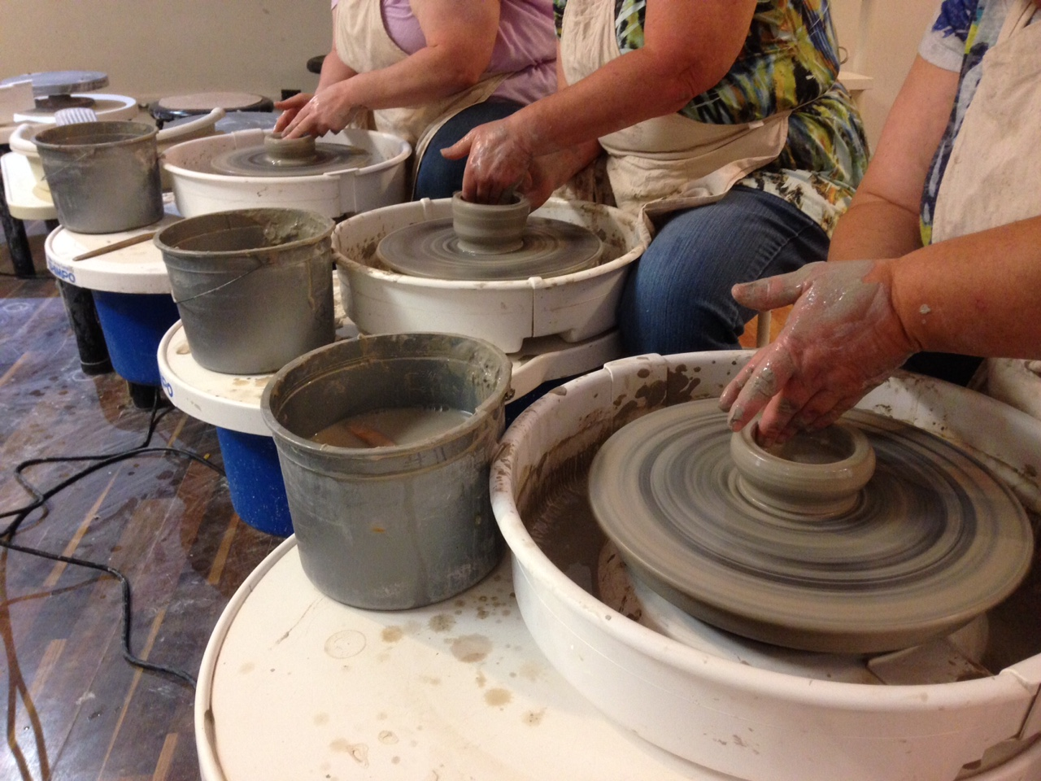
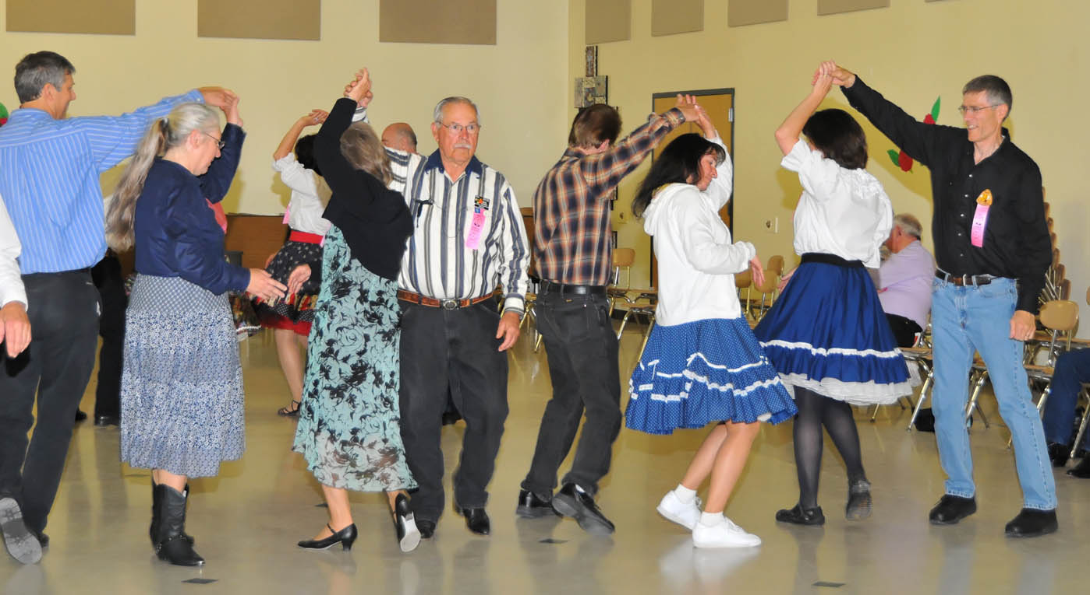
What Some People Think It Is:
ADULT EDUCATION
Notes:
And of course, there are people who confuse adult education with evening enrichment classes!

Slide 5

What the Students Think It Is:
ADULT EDUCATION
Notes:
As you instructors know very well, adult education students often have to work at jobs and take care of families.

Slide 6


What the Students’ Children Think It Is:
ADULT EDUCATION
Notes:
As you instructors know very well, adult education students often have to work at jobs and take care of families.

Slide 7

What Some School Districts Thought It Was:
ADULT EDUCATION

Slide 8


What We Know it is Not:
ADULT EDUCATION
Notes:
It is certainly not “money out the window.” We have allies in the Michigan Legislature, but too many legislators think this way.

Slide 9
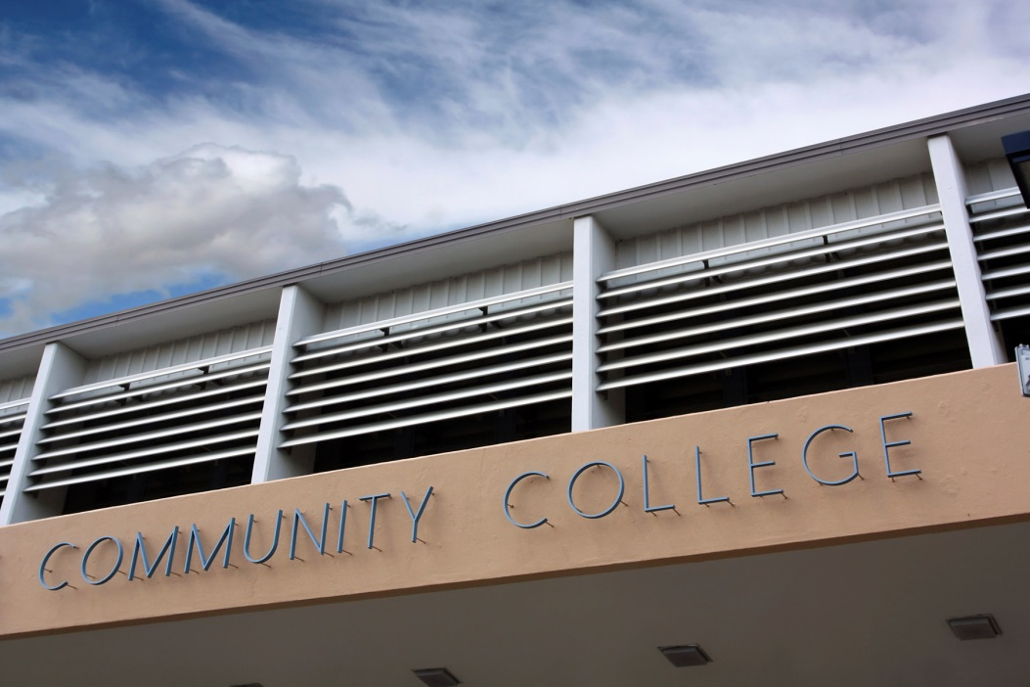
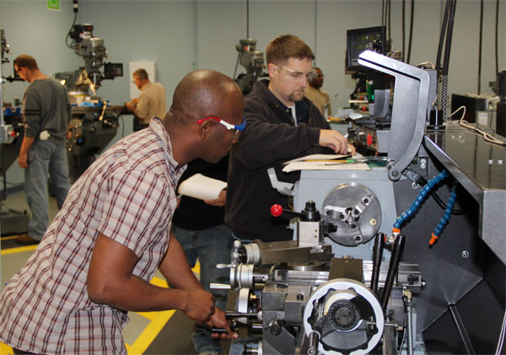
What It Really Is:
ADULT EDUCATION
A crucial transition into postsecondary education or training leading to a credential.
Notes:
Now the handouts kick in again, minus some graphics!
So let’s talk about the purpose of adult education. It is NOT simply a GED, as many people believe.

Slide 10

ADULT EDUCATION
What It Really Is:
An investment in Michigan’s workforce that lifts incomes, stimulates economies, and reduces need for public assistance.
Notes:
It is not money spent simply to help people. It is an overall investment in the economy and in the future.

Slide 11
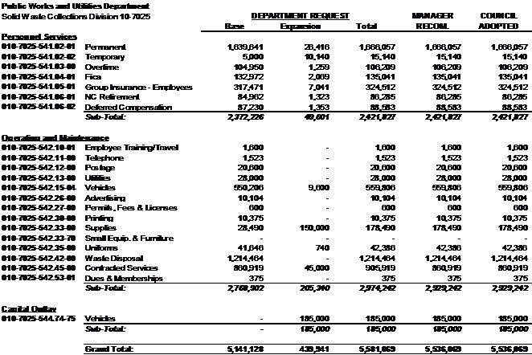
ADULT EDUCATION
What It Really Is:
A line item in the state budget that must be increased.
Notes:
Don’t squint your eyes—this is just a graphic! ☺
It is in a separate line item (Sec. 107) of the School Aid Fund—separate to protect it from community pressures to put the money into K-12. As we unfortunately know, adult students are not a high priority for school districts and communities. We do need to fund K-12 better in this state, but we do not want adult education funds to get caught up in K-12 funds because adult education will always lose.

Slide 12
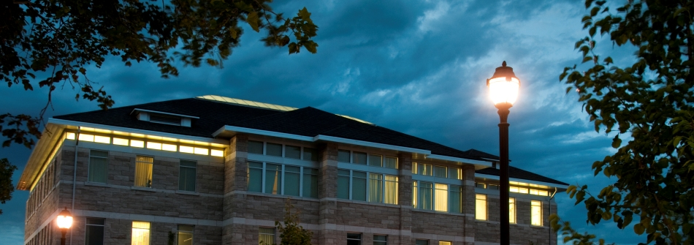
ADULT EDUCATION
What It Really Is:
Night school, which works well for many students, but also…
Notes:
With adequate resources,
adult education can expand into:
community colleges
workplaces
2-generation sites
We’ll talk about these expansion possibilities in a little bit.

Slide 13
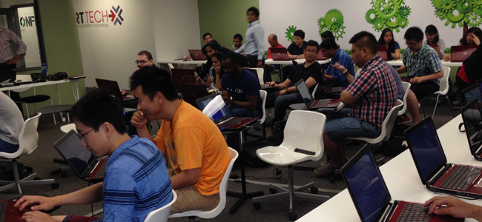

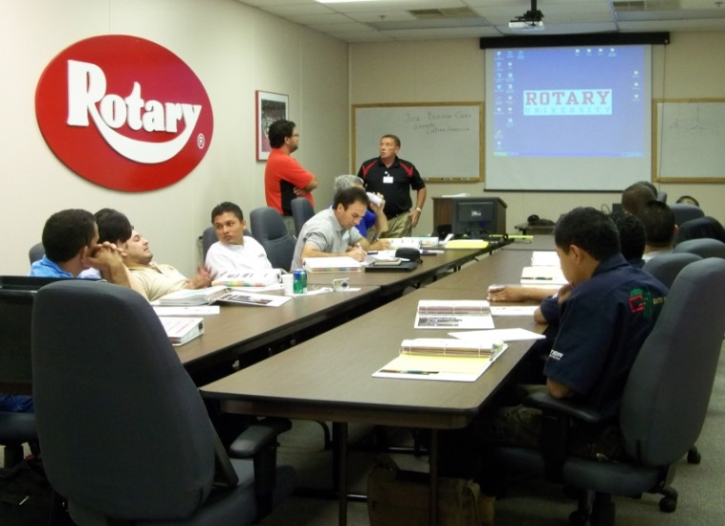
ADULT EDUCATION
What It Really Is:
…an opportunity to expand beyond (not replace!) the traditional “night school” model.
Notes:
With adequate additional funding!!!
adult education can expand into:
community colleges
workplaces
2-generation sites
We’ll talk about each of these expansion possibilities today. But first…

Slide 14
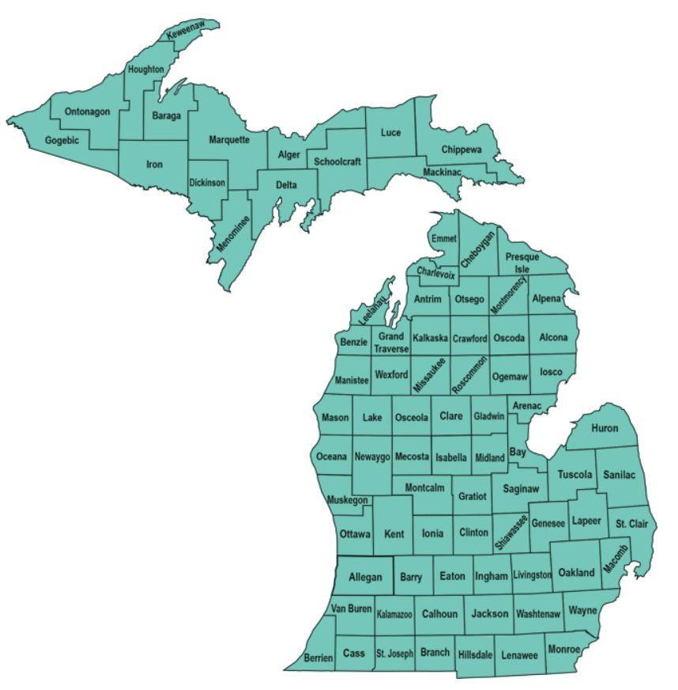
Who in Michigan needs adult education?
Notes:
OK, now your handouts will be synchronized with the slide show!
So, who in Michigan needs adult education?

Slide 15
Education Level in Michigan,
Age 25 and Over (2016)
Less than 9th grade | 203,405 | 3.0%
9th to 12th grade, no diploma | 444,504 | 6.6%
High School (incl. equiv) | 1,978,343 | 29.3%
Some College, no degree | 1,598,192 | 23.6%
Associate's degree | 626,128 | 9.3%
Bachelor's degree | 1,162,737 | 17.2%
Graduate or professional degree | 747,093 | 11.1%
647,909 9.6%
Notes:
We see here that just under 648,000 Michigan residents 25 and over do not have a high school diploma. Those residents definitely should be in adult education, to complete high school and transition into postsecondary training.

Slide 16
Earnings and Poverty by
Educational Level (2016)
 | Median Earnings | Poverty Rate
Less than high school graduate | $20,512 | 28.8%
High school graduate (includes equiv.) | $27,202 | 14.7%
Some college or associate's degree | $32,435 | 10.4%
Bachelor's degree | $50,821 | 4.3%
Graduate or professional degree | $68,906 | N/A
Notes:
“Some college or associates degree”---frustrating not broken out. If “associates degree or other middle skills credential,” figure would be higher.

Slide 17
Is Michigan’s adult education system serving enough people?
6.6%
In 2015-16…
Over 210,300 Michigan adults age 25-44 lacked a high school diploma or GED.
Fewer than 7% of these adults were enrolled in adult education.

Slide 18
Is Michigan’s adult education system serving enough people?
3.6%
In 2015-16…
More than 225,000 Michigan adults age 25-44 spoke English less than “very well.”
Fewer than 4% of these adults were enrolled in ESL adult education programs.
Notes:
And by the way, 25-44 only because that was the only age bracket in which we could get apples-to-apples percentage.

Slide 19
Adult Education as 2-Generation Strategy
Challenges and Solutions
Notes:
It is extremely difficult for children to attain a higher level of education than their parents. Educating the parents leads to better outcomes for children.

Slide 20
Adult Education as 2-Generation Strategy
Recent findings in brain science underscore this fact: the development of children and parents is inextricably linked. Parents gain motivation to succeed from their children and vice versa; their efforts are mutually reinforcing.
~The Aspen Institute
Notes:
It is extremely difficult for children to attain a higher level of education than their parents. Educating the parents leads to better outcomes for children.

Slide 21
Adult Education as 2-Generation Strategy:
The Challenges
9,607 adult education students had school age children in 2015-16

Slide 22
Adult Education as 2-Generation Strategy:
The Challenges
6,047 adult education students had preschool age children in 2015-16

Slide 23
Adult Education as 2-Generation Strategy:
The Challenges
2,215 adult education students reported being single parents in 2015-16

Slide 24
Adult Education as 2-Generation Strategy:
State Policy Solutions
Fund child care
at more adult education sites.
Fund more adult education classes in programs that serve children.
Inform students of assistance (incl. CDC subsidy) for which they may be eligible.
enrichment activities

Slide 25
Adult Education as 2-Generation Strategy:
State Policy Solutions
Make low-income adult ed students categorically eligible for child care subsidy.
Make adult education an integral part of all Pathways to Potential programs.
Allow adult education to count as a TANF work activity.
Notes:
Child care subsidy: we shortchange this subsidy and the League has advocated very strongly to bring it more in line with market rates and expand eligibility. We should include expanding eligibility to categorically include low-income adults who are in adult education.
Pathways to Potential
Right now, completing a high school diploma cannot count as a TANF work activity for parents over age 20 who receive cash assistance. That is a federal rule, but Michigan has the flexibility to count it anyway, because so many cash assistance recipients ARE meeting the federal work requirements.

Slide 26
One Idea: Bring Adult Education into the Community Colleges
Developmental education classes cost tuition, but AE is free.
Providing AE at community colleges facilitates GED students continuing into post-secondary.
Community colleges and ISDs can enter into cooperative transfer agreements.
Notes:
Community colleges are burdened by the need for remediation and do not see developmental education as a moneymaker.
No competition with adult ed.
CC population benefits by saving money.
GED population benefits by being in a CC.
Transfer Wizard model.

Slide 27

Many Community College Students Could Benefit from Adult Education
Percentage of Michigan community college students taking at least one developmental education class in 2015-16.
56%
Notes:
Costs money, burns through financial aid, increases the likelihood of dropping out of college before attaining a credential. This is a bit lower than the past several years, however, which hovered around 60%.

Slide 28
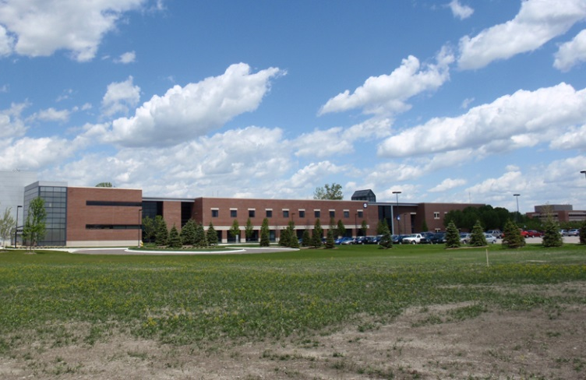


Adult Education in Community Colleges:
A Win-Win-Win!
Community colleges would be relieved of some of the developmental education burden.
Adult education could expand its reach.
Students would save money and be less likely to drop out.
Notes:
Not everyone will feel comfortable going to a community college for AE—the current “night school” model is better for some. But for others not yet enrolled in community college, being on campus might be beneficial.

Slide 29


Another Idea: Bring More Adult Education into the Workplace
Helps employees who can’t advance due to language, literacy or mathematics deficiencies.
Can help with transportation barriers and reduce driving time.

Slide 30
.2%?

Slide 31

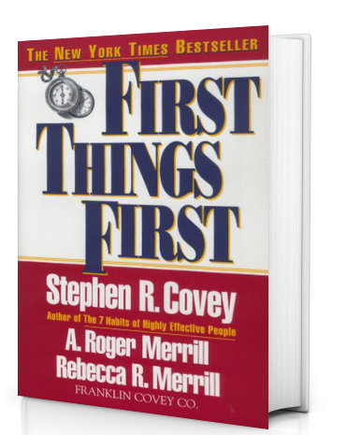
However, we must first secure the necessary funding to maintain current modes of delivery.
Notes:
Expanding into the community colleges and into workplace sites is a good long-term goal that would benefit many people. However, right now, there are many areas of the state without any adult education at all. We have to make sure we increase the overall funding for adult education to strengthen what we have now.

Slide 32

Serving more students requires money.
How are we doing on that?
Notes:
As we know…
And the $23 million dollar question is…

Slide 33
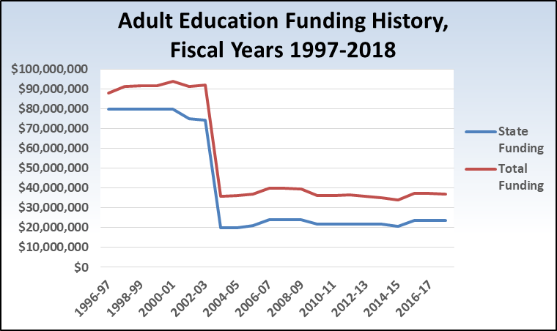
Not so well.
$23,750,000
Notes:
The state has cut adult education deeply in the past 20 years! From $80 million in 1997 to $80 million for several years to $23.75 million in 2017-18. Prior to that, $185 million and even higher n in some years, but that was under a different funding stream and not always used well, so let’s focus on the $80 million.

Slide 34
Adjusting for inflation, Michigan has cut state funding for adult education by 79% since 2001!

Slide 35
Notes:
We don’t have the figures for 2016-2017 school year yet—that will be in the next version of the paper.

Slide 36
Notes:
From Program Year 2009-12 to 2015-16, when adult education received state and federal funds averaging $35.9 million per year, the state served an average of 28,340 adult education students per year.
Assuming a cost of $1,266 per student, if total funding were to be increased by $10 million, then the state could serve just under 7,900 more students—an increase to a total of 36,237 students. Hypothetically, if the 7,900 additional students were between the ages of 25 and 44, then the percentage of individuals that age without a high school diploma or GED who are enrolled in adult education would go from 6.4% to 10%.
This slide shows approximately how many more students the adult education system could serve if funding is increased. (The table does not account for inflation.) While we do not necessarily recommend that only adults age 25-44 without a high school diploma be targeted for additional money, the percent of this population that would be served with increased funding serves as a useful benchmark.

Slide 37

Preserving Pieces of Shrinking Pie
Social
Services
K-12
Community
Services
Community
Colleges
Adult Education
Notes:
State budget and revenue issues are adult education funding issues!

Slide 38

Grow the Pie!

Slide 39
Recommendations
Increase AE Capacity
Increase adult education funding by at least $10 million in the next budget, to educate approximately 7,900 more adults.
Increase funding for inflation each year afterward.
Support tax and revenue policies that will not endanger adult education funding.
Notes:
The Legislature increased funding by only $3 million for 2015-2016, which is not enough, but it is a start.

Slide 40
Recommendations
Expanding AE in Nontraditional Settings
Incentivize cooperative adult education agreements between community colleges and school districts, perhaps as a pilot program.
Incentivize employers to provide match funding for adult education at their worksites.

Slide 41
Recommendations
AE as a 2-Generation Strategy
Allow FIP recipients to count AE as a work activity.
Fund child care at AE sites.
Incentivize AE at programs serving children such as Head Start.
Make AE students categorically eligible for child care subsidy.

Slide 42

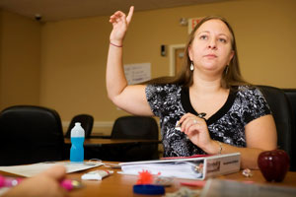





Questions?

Slide 43


Peter Ruark pruark@MLPP.org
Website: www.MLPP.org
Sign up for “Email Alerts”
Become a Michigan League member

