Slide 1

TASC Test Overview

Slide 2
Data Recognition Corp.
Based in Maple Grove, MN
  Office on West Road in East Lansing
Full-service, large-scale assessment publisher, founded in 1926
Over 50 years experience serving adult education community with high quality, nationally researched assessment (paper, online, adaptive)
Strong content development capabilities, authoritative assessment expertise, universal design/accessibility leadership, engaging and rigorous content
Highly accomplished research and psychometric staff and practices ensure validity, reliability, professional support
Well engineered, robust systems from content management through test delivery and reporting

Slide 3
DRC/CTB History in Adult Education Assessment
TABE 1 & 2 1967
TABE 3 & 4 1975
TABE 5 & 6 1983
TABE 7 & 8 1994
TABE 9 & 10 2003
TABE 9&10 Online 2006
TABE CLAS-E (ESL) 2007
TASC (High School Equivalency) 2014
TABE Free Formative CCR Tests 2014
TABE 11 & 12 2017

Slide 4
The National TASC Test Landscape
Pending States:
Ohio – TASC Test, HiSET, GED
Michigan – TASC Test, HiSET, GED
Minnesota
Virginia
Current States:
California – TASC Test, HiSET, GED
Colorado – TASC Test, HiSET, GED
Illinois – TASC Test, HiSET, GED
Indiana – TASC Test
Mississippi – TASC Test, GED
New York – TASC Test
Nevada – TASC Test, HiSET, GED
New Jersey – TASC Test, HiSET, GED
North Carolina – TASC Test, HiSET, GED
Oklahoma – TASC Test, HiSET, GED
South Carolina – TASC Test, GED
South Dakota – TASC Test, GED
Texas – TASC Test, HiSET, GED
West Virginia – TASC Test

Slide 5
The TASC Test
Format, Design, Item Types

Slide 6
TASC Test Overview
TASC test is a secure, reliable and valid assessment that indicates whether test-takers have knowledge in core content areas equivalent to that of graduating high school students.
Launched on January 2, 2014
Three new forms published each year in both English and Spanish
  Current forms are G, H & I
Alternate formats are Braille, large print, and audio
Available Paper/Pencil (PBT) and Computer-Based (CBT)
5 Subtests:
      Reading
      Writing
      Math
      Science
      Social Studies

Slide 7
TASC Content Frameworks
English Language Arts
  College and Career Readiness Standards for Adult Education
Mathematics
  College and Career Readiness Standards for Adult Education
Science
  Next Generation Science Standards
Social Studies
  CTB Social Studies Standards are based on national frameworks in the areas of US history, world history, civics and government, and economics

Slide 8
TASC Test Content Overview
Reading: Assesses an examinee’s ability to understand the information presented in excerpts from newspapers, magazines, novels, short stories, poetry, drama, and business or legal text passages. Includes both literary and informational texts.
Writing: Examinees must identify errors and make corrections in sentence structure, usage, mechanics, and organization. Examinees will also write a text-based essay.
Mathematics: Assesses quantity, algebra, functions, geometry, and statistics and probability. Most are word problems and involve real-life situations or ask examinees to interpret information presented in diagrams, charts, graphs, and tables. Examinees are given a page of Mathematic formulas to use during the test.
Science: Assesses Physical Science, Life Science, and Earth and Space Science. Each discipline is subdivided into several core ideas, which each containing multiple performance expectations. Each test items assess one performance expectations. Items may require recalling knowledge, applying knowledge and skills or reasoning.
Social Studies: Examinees answer questions on history, economics, geography, civics, and government. The Social Studies test gauges examinees’ understanding of the basic principles in each of those areas.

Slide 9
TASC GHI DOK Item Distribution
Subtest | DOK 1 | DOK 2 | DOK 3 | DOK 4
Reading | 10% | 65% | 25%
Writing | 10-15% | 65-70% | 20%
Writing Essay |  |  |  | 100%
Mathematics | 10-20% | 55-75% | 20-30%
Science | 15-20% | 65-70% | 15-20%
Social Studies | 8% | 72% | 20%

Slide 10
TASC GHI Testing Times
Subject | English and Spanish Testing Time in Minutes
Mathematics Part I (calculator) | 55
Mathematics Part II (non-calculator) | 50
Reading | 85
Science (calculator) | 75
Social Studies | 75
Writing | 110 (45 minutes of this is for the essay portion)

Slide 11
TASC Item Types
Item Types | Subtests | Scoring
Selected-response | All subtests | Machine scored
Writing prompt | Writing subtest | Hand scored
Gridded-response | Math subtest | Machine scored
Technology-enhanced* | All computer-based subtests | Machine scored
TE Twin | All paper-based subtests | Machine scored
*Technology-enhanced item types
Drag and drop
Multiple correct response
Evidence-based selected response

Slide 12
Item Counts by Item Type - GHI
Subject | MC | GR | TE 1-point | TE 2-point | ECR Items
Mathematics | 43 | 12 | 1 | 1 | n/a
Reading | 48 | n/a | 1 | 1 | n/a
Science | 48 | n/a | 1 | 1 | n/a
Social Studies | 46 | n/a | 1 | 1 | n/a
Writing | 47 | n/a | 2 | 1 | 1

Slide 13
TASC Cut Scores
Subject | Passing Score | Distinguished Achievement Score
Language Arts Reading | 500 | 580
Mathematics | 500 | 560
Language Arts Writing | 500 and at least a 2 out of 8 on the Writing Prompt | 560 and at least a 6 out of 8 on the Writing Prompt
Science | 500 | N/A
Social Studies | 500 | N/A

Slide 14
TASC JKL Release
  Last day of GHI testing is 1/13/18
  JKL release starts on 1/16/18
  Smooth transition to new series
    Same platform
    Build on performance improvements
Description | Dates to Block | Comments
English CBT | 1/14/18 - 1/15/18 | English online testing starts 1/16/18
English PBT | 1/14/18 - 1/18/18 | English paper testing starts on 1/19/18
Spanish CBT | 1/14/18 - 2/1/18 | Spanish online testing starts 2/2/18
Spanish PBT | 1/14/18 - 1/18/18 | Spanish paper testing starts on 1/19/18

Slide 15
What’s New for Forms JKL?
Forms JKL
Item Types | Constructed Response Questions have been removed except for the Essay
Blueprints | A shift has occurred in the Science Blueprint
Science Area | GHI | JKL
Earth and Space Sciences | 40% | 25%
Life Sciences | 40% | 50%
Physical science | 20% | 25%

Slide 16
Receiving Results
Paper-Based Testing (PBT)
  Send to DRC-CTB TASC Scoring Facility
  Highly-qualified staff read and holistically score student CR items and essays
  Allow 5-10 days for all scoring (current avg. 2-3 business days)
  Examinees can access results on ORSS
Computer-Based Testing (CBT)
  Preliminary results on selected-response items available immediately
  Highly-qualified staff read and holistically score student CR items and essays
  Allow 3-5 business days for hand-scoring essay section (current avg. 2-3 business days)
  Examinees can access results on ORSS

Slide 17
TASC Test Readiness Assessment
Free Practice Test--sample items: TASCTest.com
Official TASC Readiness Test
  Developed and field tested with TASC
  Half the length of TASC
  Provides diagnostic information and indicators of TASC success
  Available in English and Spanish formats
Available both Computer-Based and Paper-Based
  Paper test scored locally/online scored immediately
  $11 per student—all sub-tests

Slide 18
TASC Test Fee Structure
TASC’s Test fee is $54 ($10.80 per content area)
Michigan’s Testing fee is $124.00 ($24.80 per content area)
– Includes 2 free retests per student

Slide 19
ORSS
Online Registration and Scheduling System

Slide 20
ORSS
Examinee self-registration portal allows examinees to:
  Self-register and generate UUID
  Request test availability at local test center
  Pay for assessment
  Check preliminary results
  Request duplicate transcripts if needed
Test Center Registration System allows test centers to:
  Register Examinee’s for testing
  Generates TASC system Unique User ID (UUID)
  Assign examinee for online or PBT testing
  Schedule assessments
  Generate roster for testing day

Slide 21
    INSIGHT Online Assessment System
    Proven, valid, and powerful online test engine
    More than 23 million secure, online assessments delivered to date in the 2015–2016 school year
    Delivered in Georgia, Idaho, Louisiana, Michigan, Missouri, Nebraska, Nevada, Pennsylvania, South Carolina, Wisconsin, and the WIDA Consortium
    (38 member states)
    Intuitive and easy to use for students, with research-based online accessibility tools and accommodations
    Straightforward processes reduce the burdens on teachers, administrators, and department staff
No requirement for local servers or caching of files
No reliance on 3rd party applications
Both TABE and TASC will be on this platform

Slide 22
Test Center Resources

Slide 23
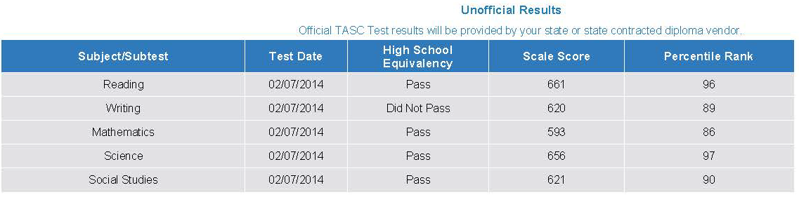
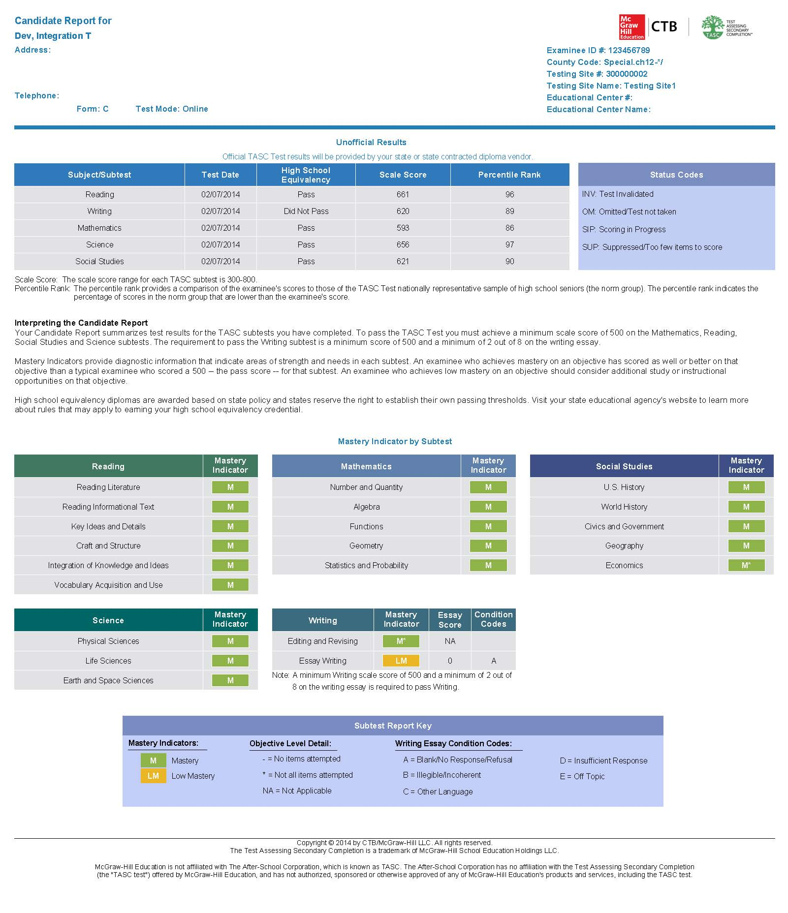
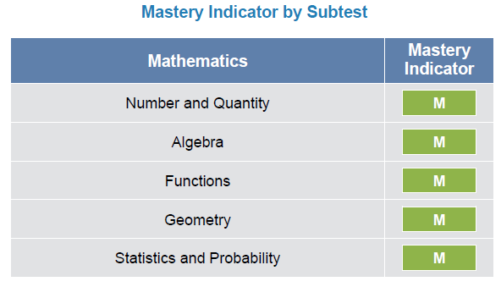
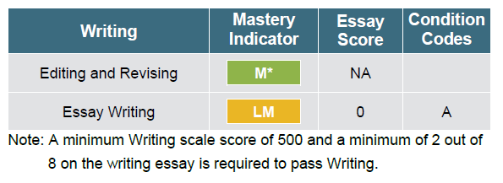
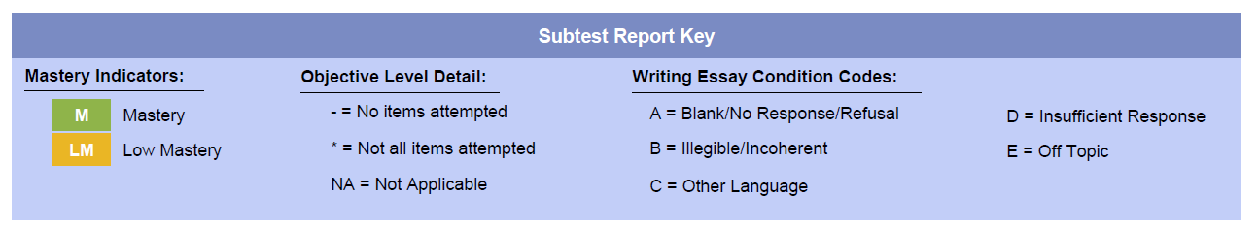
TASC Candidate Report
Subject Area Score and Pass Status
Subject Area Diagnostic Information

Slide 24
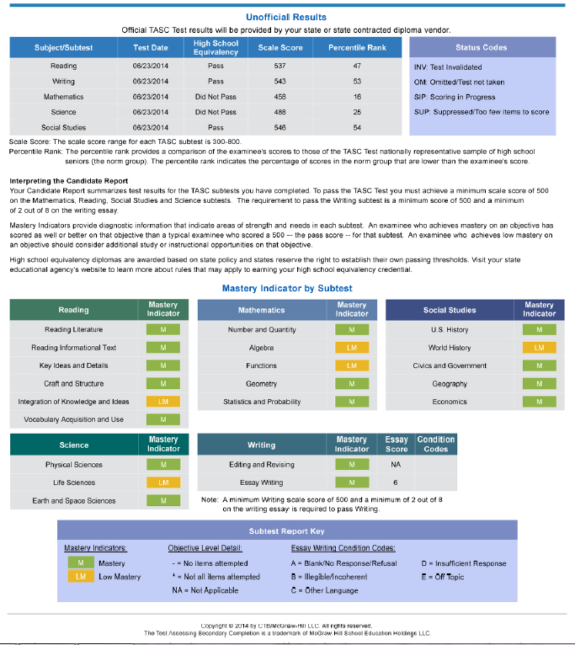
Candidate Report
Available on Examinee portal
Accessible after testing under Testing Profile
Reports are associated to test events

Slide 25
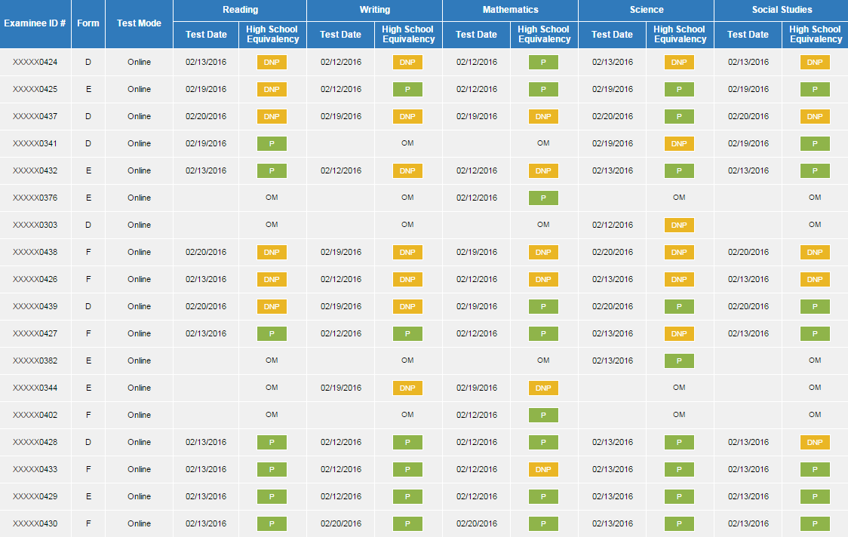
Student Roster Report

Slide 26
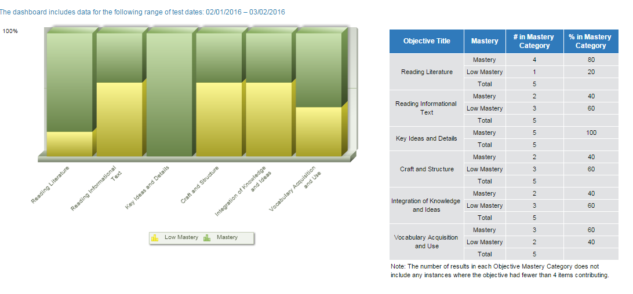
Percentage of Student Scores

Slide 27
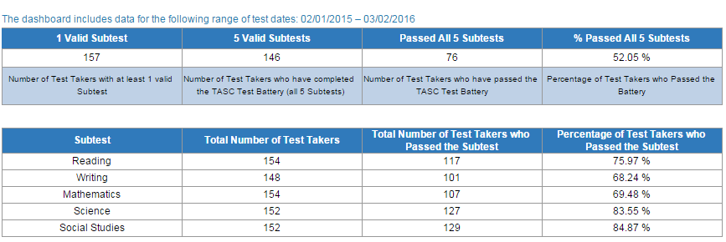
Summary Data Dashboard

Slide 28
Support for Test Centers
  Collaborative Marketing Efforts
  Product -Specific Marketing Efforts
  Social Media to Inform Potential HSE candidates
  Webinars (education, corporate)
  Testimonials (blogs, etc.)

Slide 29
Support for Test Centers
  Website: TASCTest.com
  Secure Portals: TASC Test Secure Zone
  Monthly Newsletter Spotlights and Other eMarketing Programs
  Weekly TASC Test Updates
  Social Media: Facebook, Twitter, Pinterest, LinkedIn, Blog Posts
  Videos: Product Specific, Test Center Testimonials, Demos, PD, Test Taker Success Stories etc…
  Infographics
  Webinar Series and Lunch and Learns: Product and Company Specific, Solutions-Based Approach

Slide 30


TASC Test Facebook Posts

Slide 31

A New TABE for a New Era

Slide 32
TABE Current Status
  TABE 9&10 is approved through at least 2019
  TABE Online is helping to field test new items
    Testlets are the bridge between the 2014 HSE changes and the new NRS of 2016–2017
  Computer-based testing continues its steady growth
  TABE CLAS-E approved in 20 states
    New College- and Career-Readiness (CCR) Standards pending for Adult ESL

Slide 33
NRS Changes
  Public comment period for WIOA draft regulations is closed
  Final NRS Descriptors released March 2016
  Final NRS Regulations released August 2016
    Rules for all parts of NRS testing/reporting and AEFLA funding
  October 1, 2016, was the first application date for publishers
    TABE 11&12 application submitted for NRS approval
    September 7, 2017 TABE 11/12 received 7 year NRS approval

Slide 34
NRS Changes
Example: NRS Level 1 Math
Old:
Individual has little or no recognition of numbers or simple counting skills or may have only minimal skills, such as the ability to add or subtract single digit numbers.
Students prepared to exit this level are able to decipher a simple problem presented in a context and reason about and apply correct units to the results. They can visualize a situation using manipulatives or drawings and explain their processes and results using mathematical terms and symbols appropriate for the level. They recognize errors in the work and reasoning of others. They are able to strategically select and use appropriate tools to aid in their work, such as pencil/paper, measuring devices, and/or manipulatives. They can see patterns and structure in sets of numbers and geometric shapes and use those insights to work more efficiently.
Number Sense and Operations: Students prepared to exit this level have an understanding of whole number place value for tens and ones and are able to use their understanding of place value to compare two-digit numbers. They are able to add whole numbers within 100 and explain their reasoning, e.g., using concrete models or drawings and strategies based on place value and/or properties of operations. They are able to apply their knowledge of whole number addition and subtraction to represent and solve word problems that call for addition of three whole numbers whose sum is less than 20 by using such problem-solving tools as objects, drawings, and/or simple equations.
Algebraic Thinking: Students prepared to exit this level understand and apply the properties of operations to addition and subtraction problems. They understand the relationship between the two operations and can determine the unknown number in addition or subtraction equations.
Geometry and Measurement: Students prepared to exit this level can analyze and compare 2-dimensional and 3-dimensional shapes based on their attributes, such as their shape, size, orientation, the number of sides and/or vertices (angles), or the lengths of their sides. They can reason with two-dimensional shapes (e.g., quadrilaterals and half- and quarter-circles) and with three-dimensional shapes (e.g., right prisms, cones, and cylinders) to create composite shapes. They are able to measure the length of an object as a whole number of units, which are not necessarily standard units, for example measuring the length of a pencil using a paper clip as the length unit.
Data Analysis: Students prepared to exit this level are able to organize, represent, and interpret simple data sets (e.g., lists of numbers, shapes, or items) using up to three categories. They can answer basic questions related to the total number of data points in a set and the number of data points in each category, and can compare the number of data points in the different categories.
New:

Slide 35
TABE 11&12 Overview
  New standards
    National College- and Career-Readiness (CCR) Standards
  New test length
    Only one test length; no Survey and Complete Battery
  Changes to Math sections
    Only one Math test; standards focus on Applied Math
  Improved Locator design
    Longer Locator test provides a stronger prediction to TABE
  Reading, Math, and Language tests only
  Alignment to TASC and likely other HSE exams

Slide 36
Transition from TABE 9&10 to
TABE 11&12
  TABE Online will transition from the current McGraw-Hill platform to the DRC INSIGHT platform starting in August 2017
  TABE 11&12 will be added to TABE Online (DRC INSIGHT) in 2017
  TABE 11&12 paper materials will be added to our warehouse once we hear back on the NRS application

Slide 37
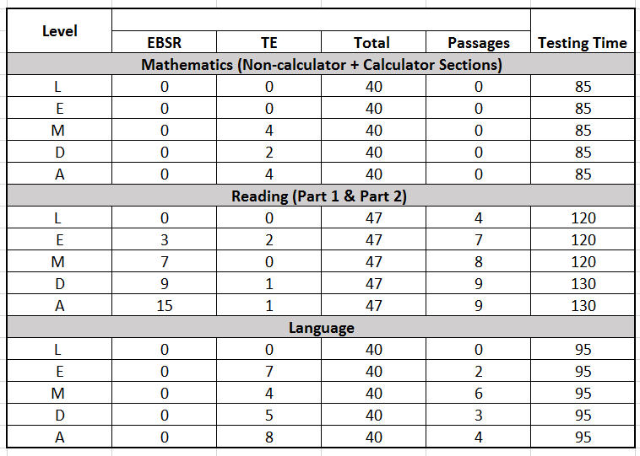
TABE 11&12: Item Types and Testing Time

Slide 38
TABE 11&12: Objectives by Level

Slide 39
TABE 11&12: Level L
  Level L can be used to screen adult examinees entering literacy programs. Level L accomplishes this by screening for:
  Visual/reversal problems
  Auditory skills/sound discrimination
  Beginning comprehension skills
  Beginning mathematics application skills
  Beginning grammar, capitalization, punctuation, and spelling skills
  Vocabulary and word meaning
  Beginning reading skills

Slide 40
TABE 11&12: Levels E/M/D/A Reading
  TABE 11&12 Reading content reflects mature, life- and work-related situations and highlights overlapping objectives, from word-meaning skills to critical-thinking skills
  These are measured using texts and forms familiar to everyday adult lives, as well as through excerpts that reflect our cultural diversity
  Based on OCTAE CCR standards focused largely on informational texts (e.g. research, scientific, historical information)
  The previous focus on literary text (e.g. fiction, memoir, poetry) is significantly decreased

Slide 41
TABE 11&12: Levels E/M/D/A Mathematics
  TABE 11&12 Mathematics reflects math application, particularly routine tasks such as estimating quantities and making computations involving time, distance, weight, etc.
  Item sets are integrated by mathematical contexts appropriate for adults
  The objective distribution at Level A is very closely aligned with the content distribution of the TASC Mathematics test

Slide 42
TABE 11&12: Levels E/M/D/A Language
  The goal of adult language instruction is to build communication skills necessary for functioning effectively on the job and in daily life
  TABE Language assesses skills in grammar, usage, mechanics, sentence formation, and paragraph development. Understanding of word meaning and relationships, context, spelling, capitalization and punctuation in sentences, phrases, and clauses is included
  Items are presented in meaningful contexts that reflect the writing process as it is applied in life

Slide 43
IV. DRC INSIGHT Test Engine

Slide 44

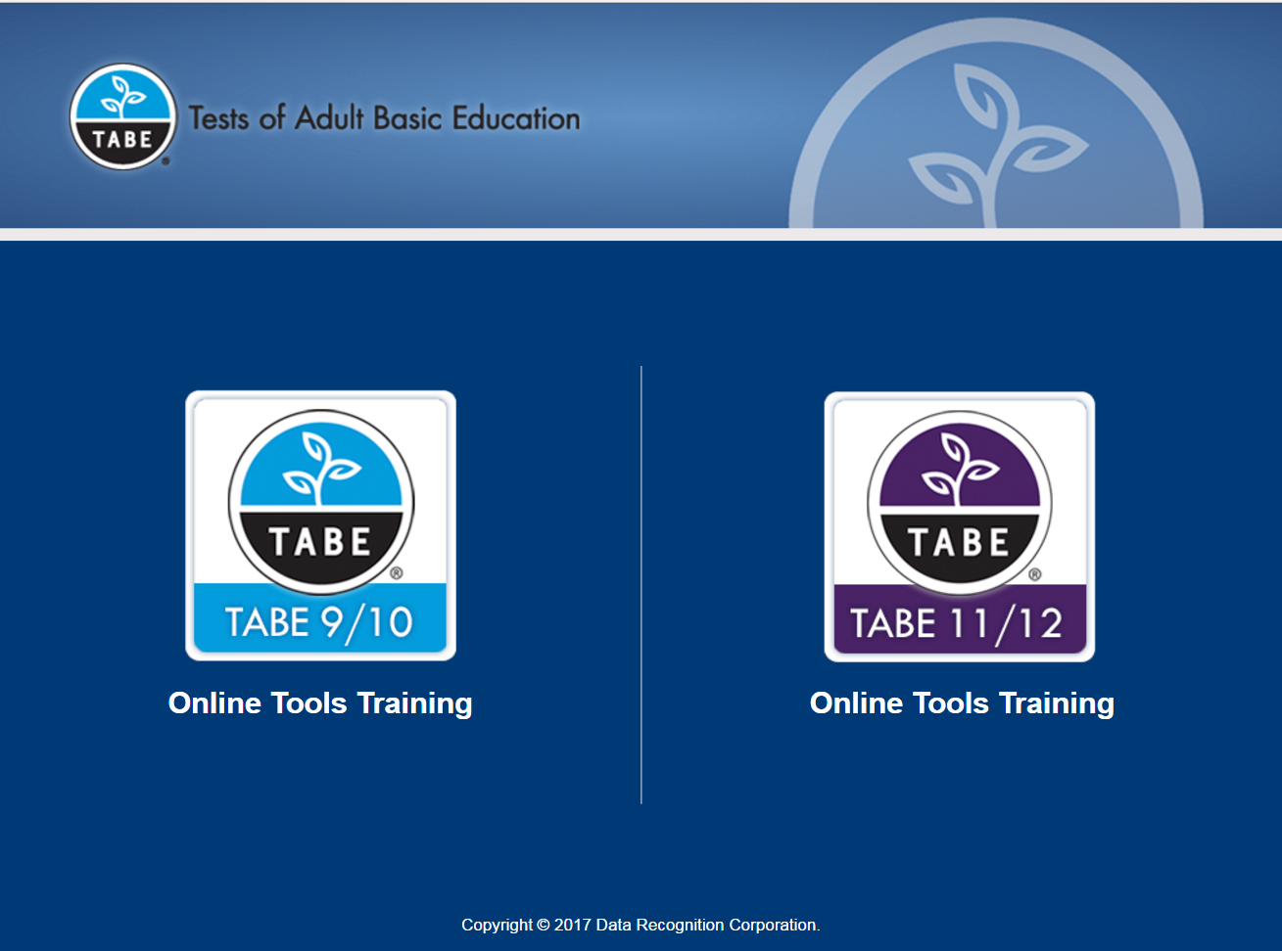

Examinee Access
44

Slide 45
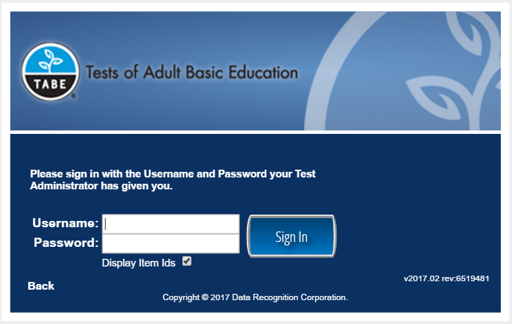
Login Screen

Slide 46
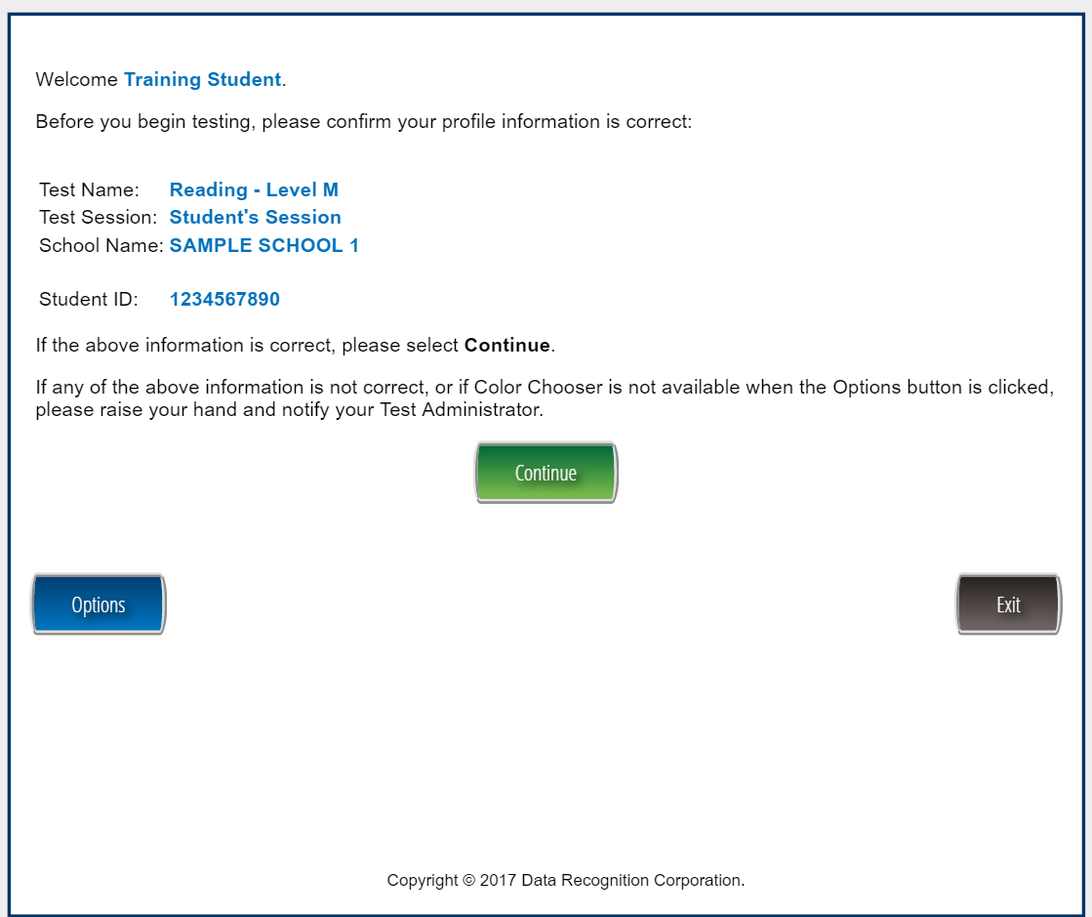
Examinee Confirmation

Slide 47
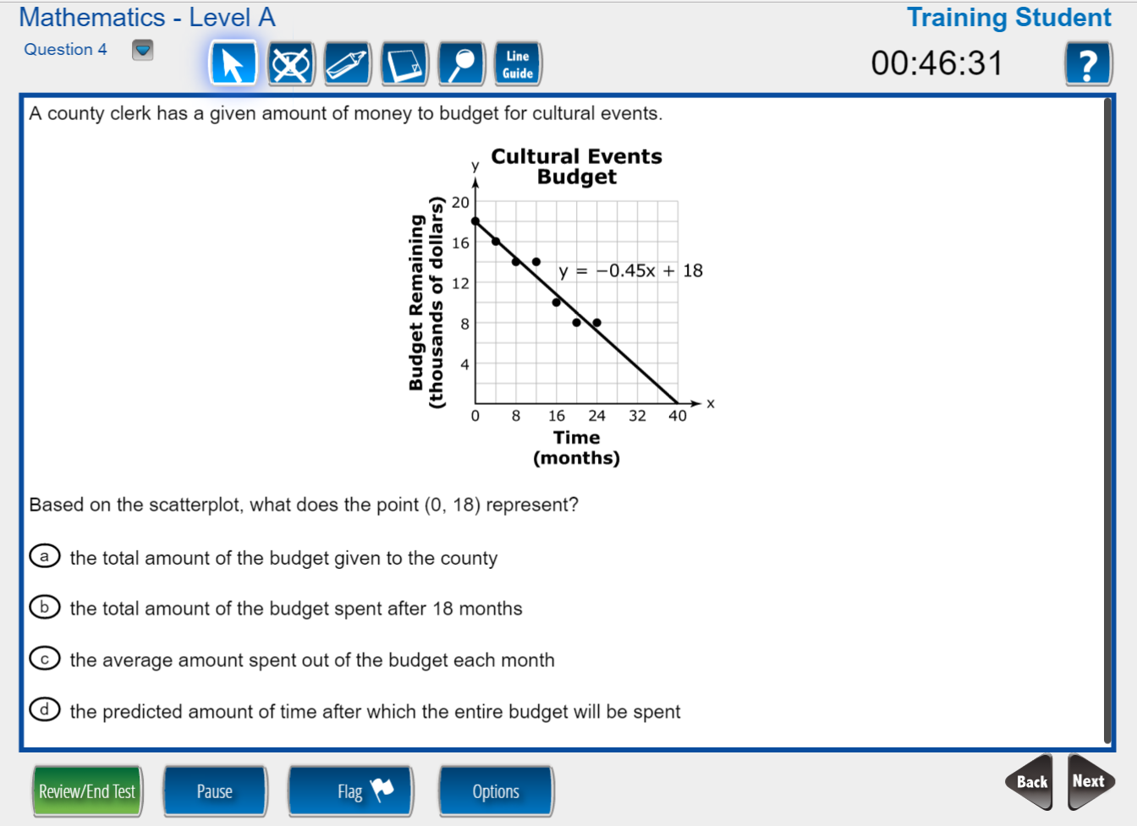
Testing Interface
47

Slide 48
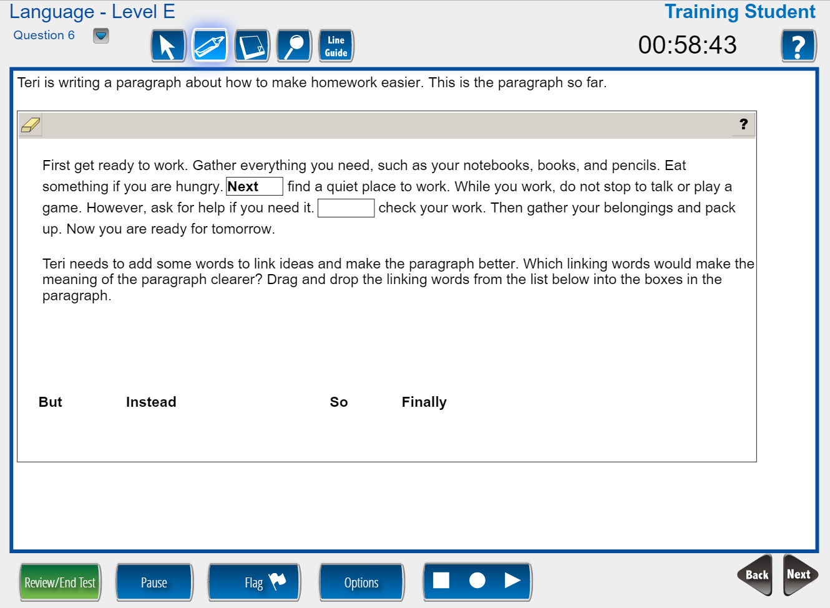
Technology-Enhanced Items
Drag and Drop

Slide 49
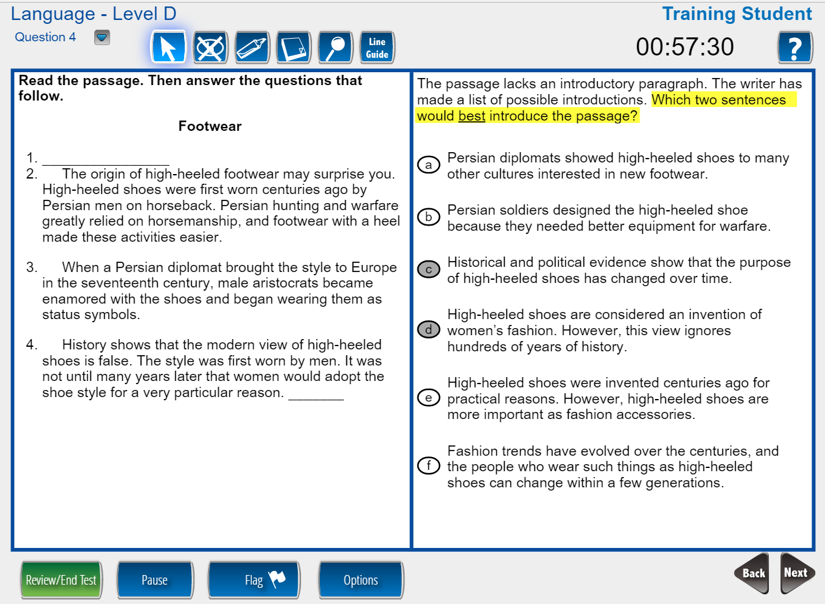
Technology-Enhanced Items
Multi-Select

Slide 50
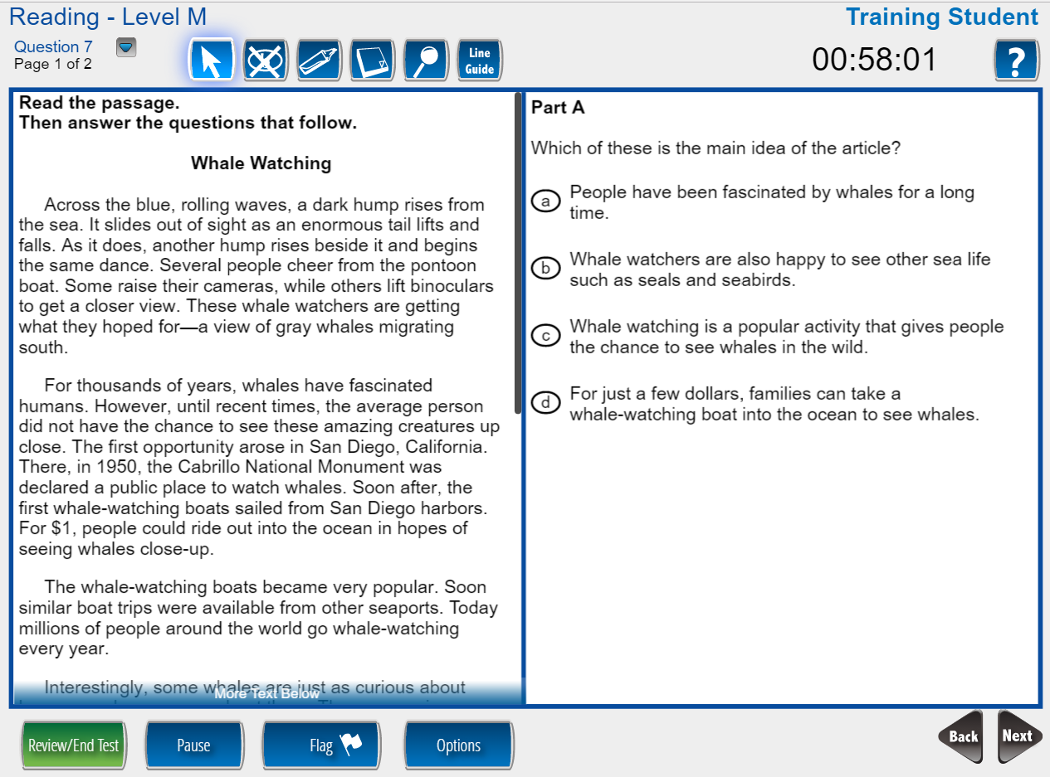
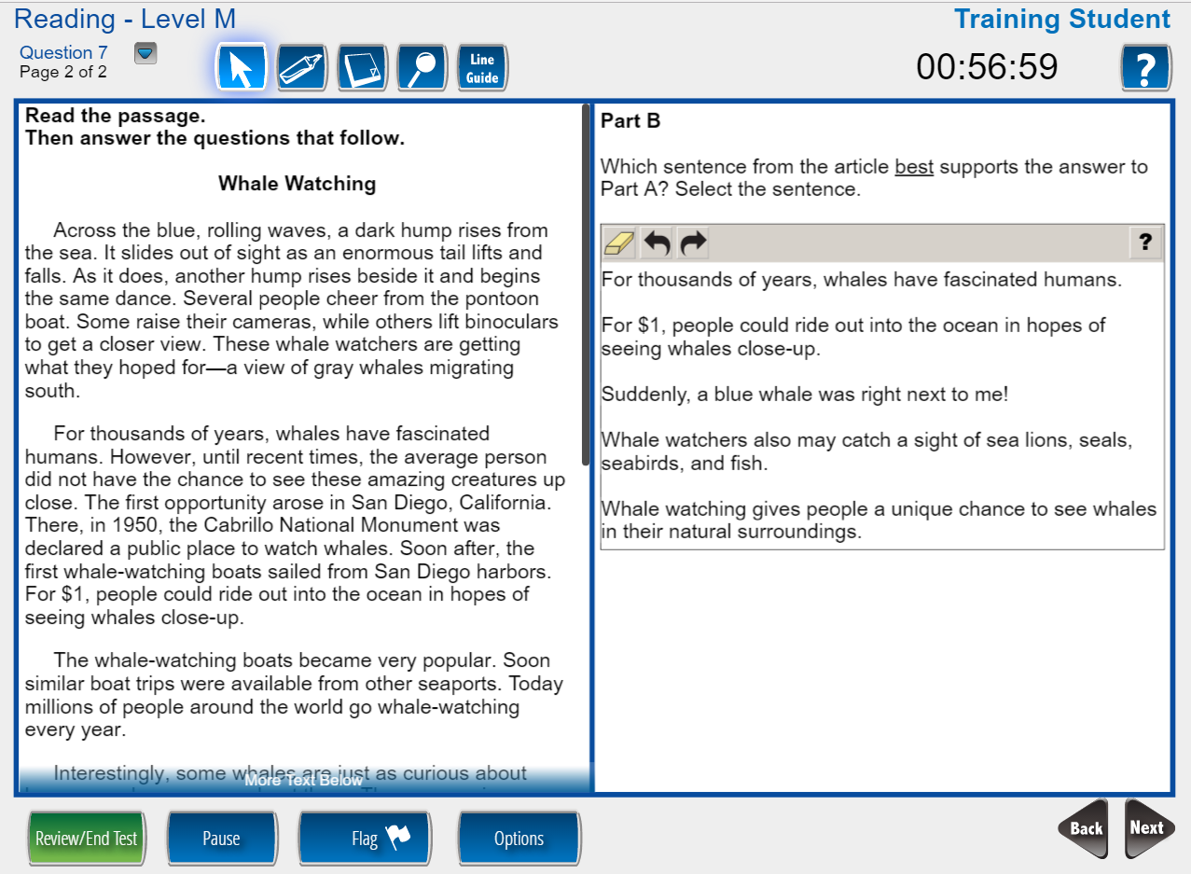
Technology-Enhanced Items
Evidence-Based Selected Response
Part A: Answer a question about the passage
Part B: Provide evidence to support your answer to Part A

Slide 51

Student Tools
TIMER
HELP TOOLS
QUICK NAVIGATION
Move to any item or passage with one click
TESTING TOOLS
Customized by item
REVIEW TEST PROGRESS
PAUSE TEST
FLAG ITEM FOR REVIEW
OPTIONS
Color Choices
Contrasting Color
Reverse Contrast
Masking
Audio Settings
BACK AND NEXT NAVIGATION

Slide 52
Student Tools (continued)
      Line Guide
      Highlighter
      Cross Off
      Magnifier/Zoom
      Sticky Notes
      Calculators
      Color Choices
      Contrasting Colors
      Reverse Contrast
      Masking
      Text-to-Speech (English)
      Online Large Print
      Mark for Review
      Pause Test
      Mathematics Formula Sheet
      Ruler (inches and centimeter)
      Protractor

Slide 53
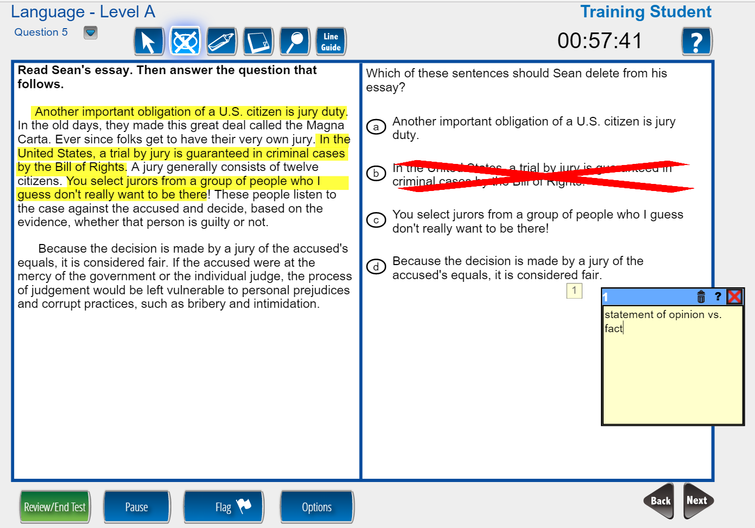
Student Tools: Highlighter, Cross Off, and Sticky Note
Multiple tools may be used simultaneously

Slide 54
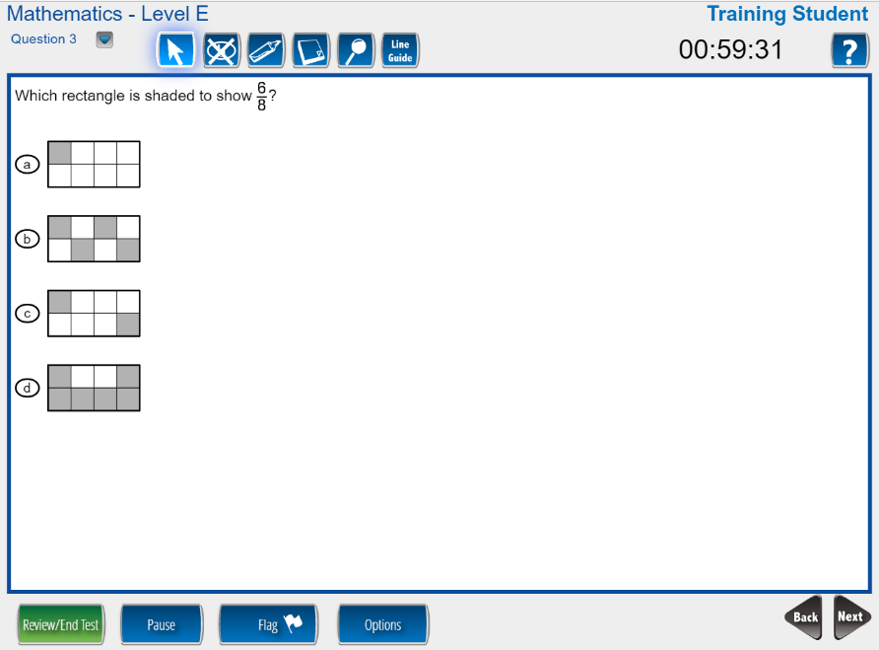
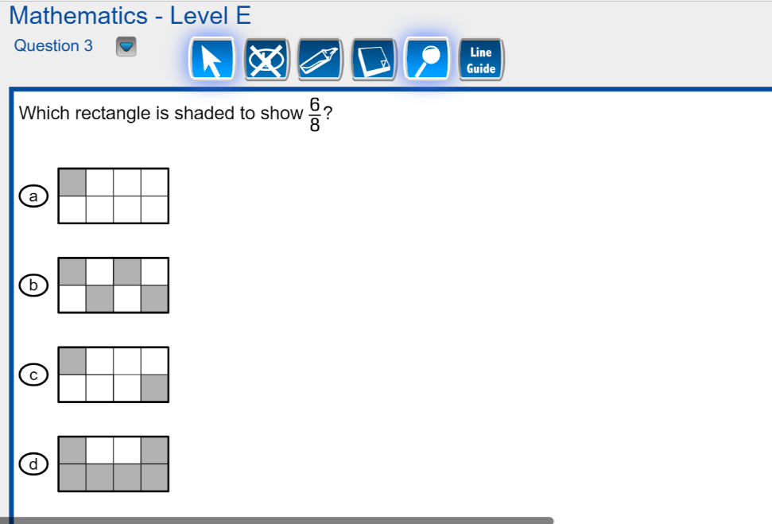
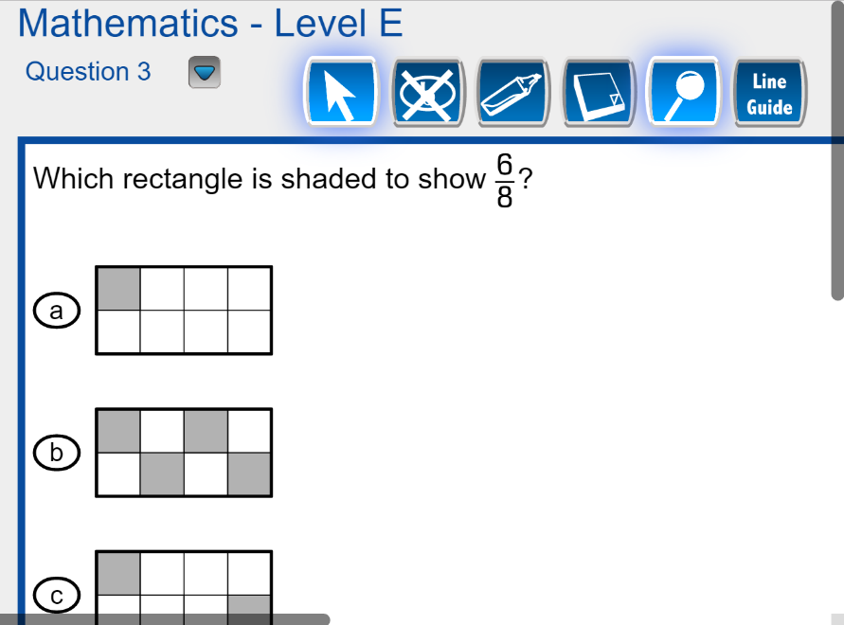
Magnifier
Standard View
1.5x Magnification
2x Magnification

Slide 55
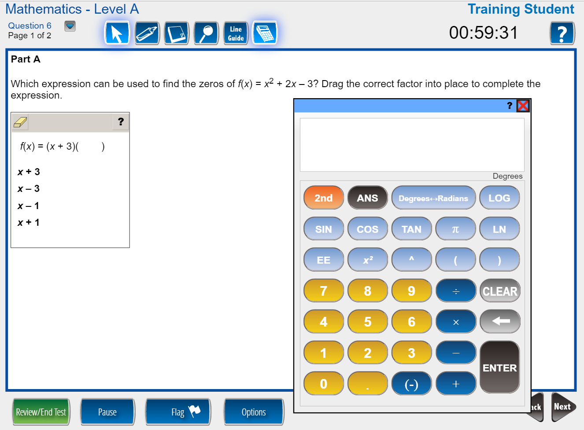
Scientific Calculator

Slide 56
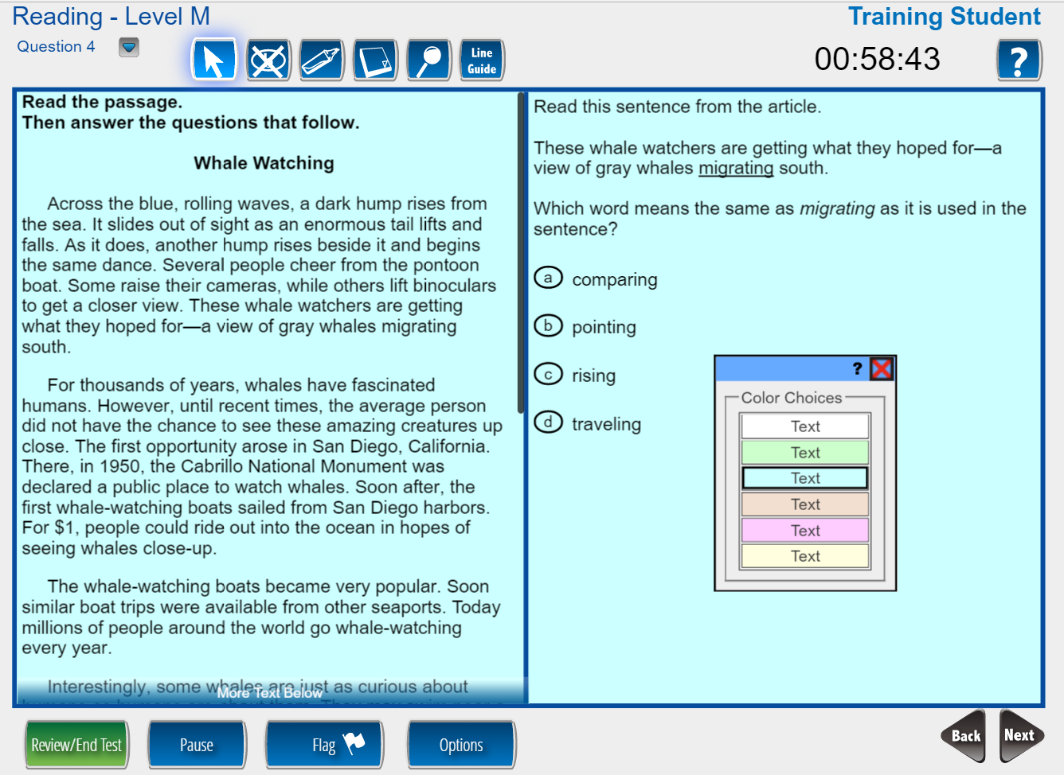
Color Choices (Overlays)

Slide 57
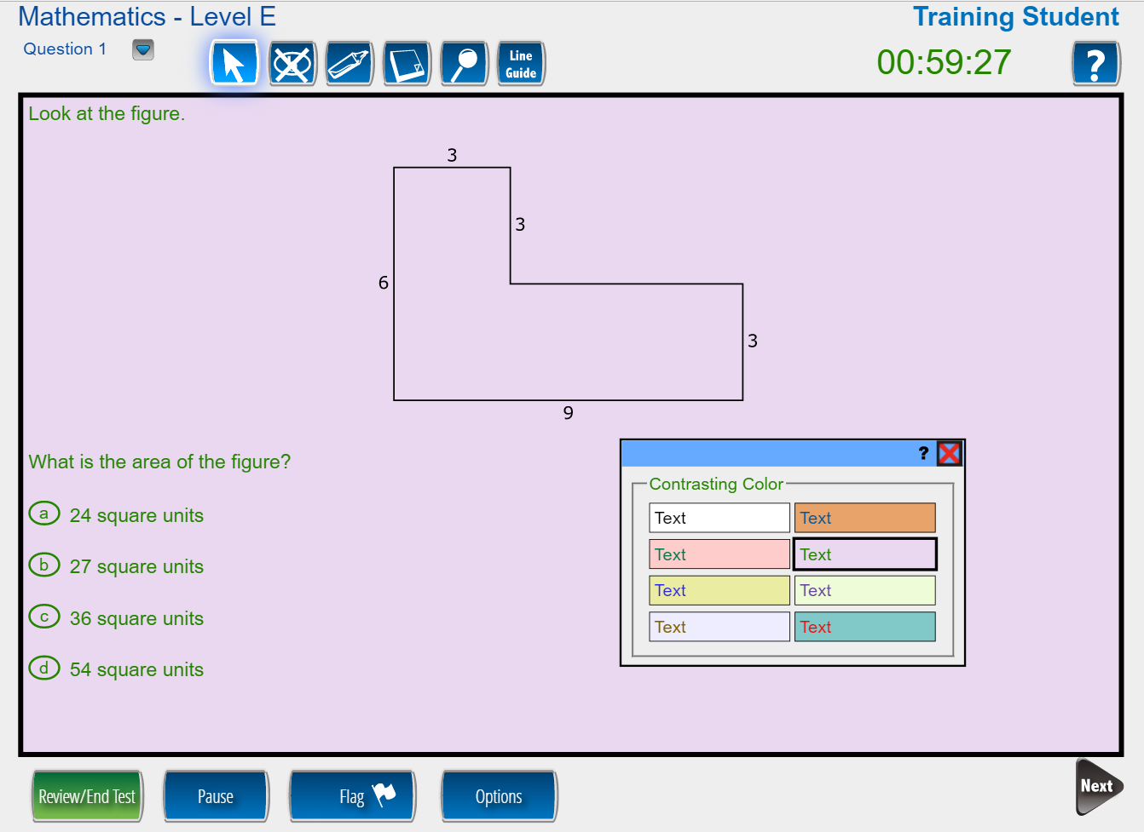
Contrasting Colors (Font and Background Color Combinations)

Slide 58
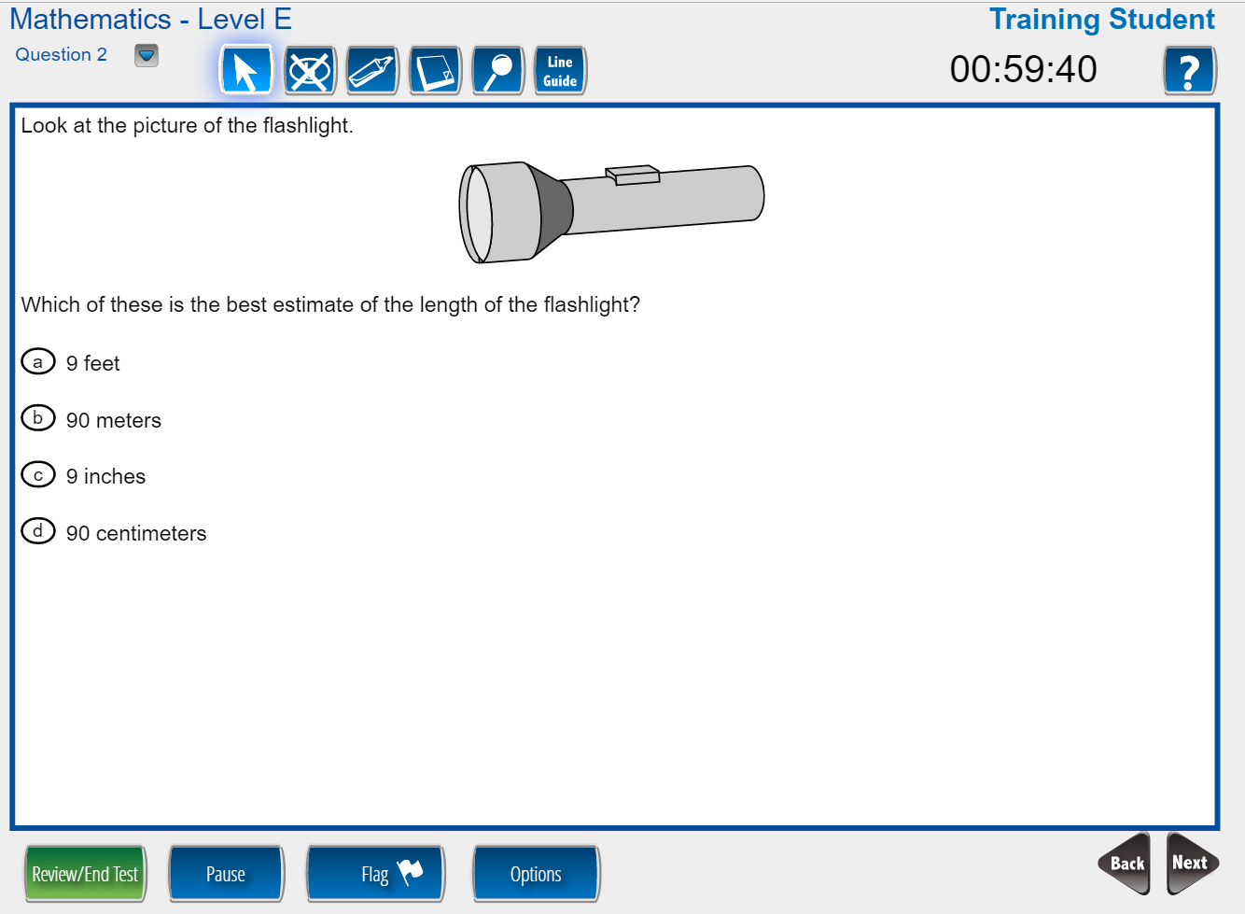
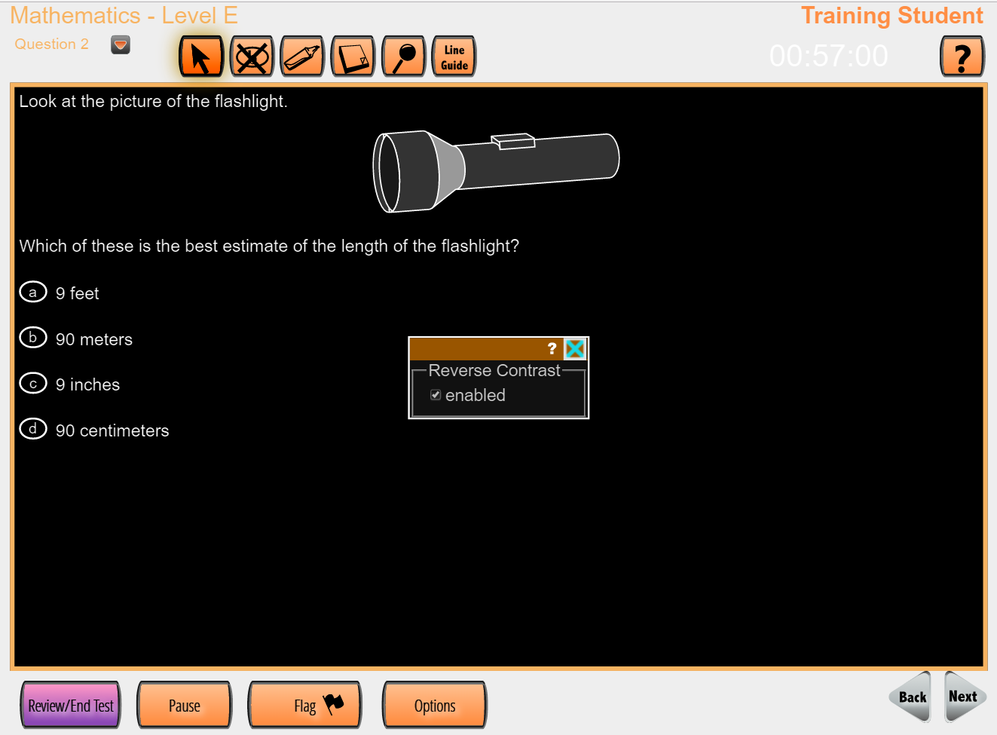
Reverse Contrast
Original Item
Item with Reverse Contrast

Slide 59
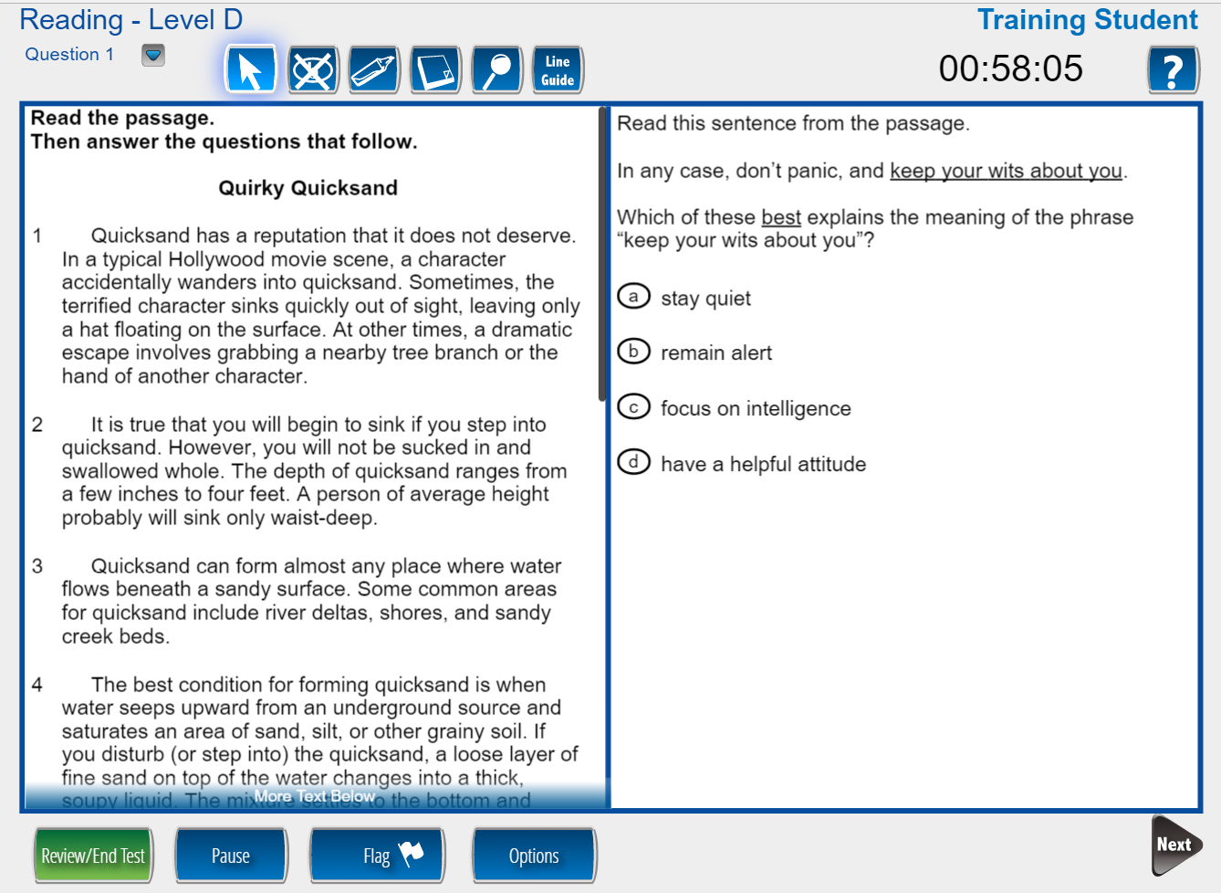
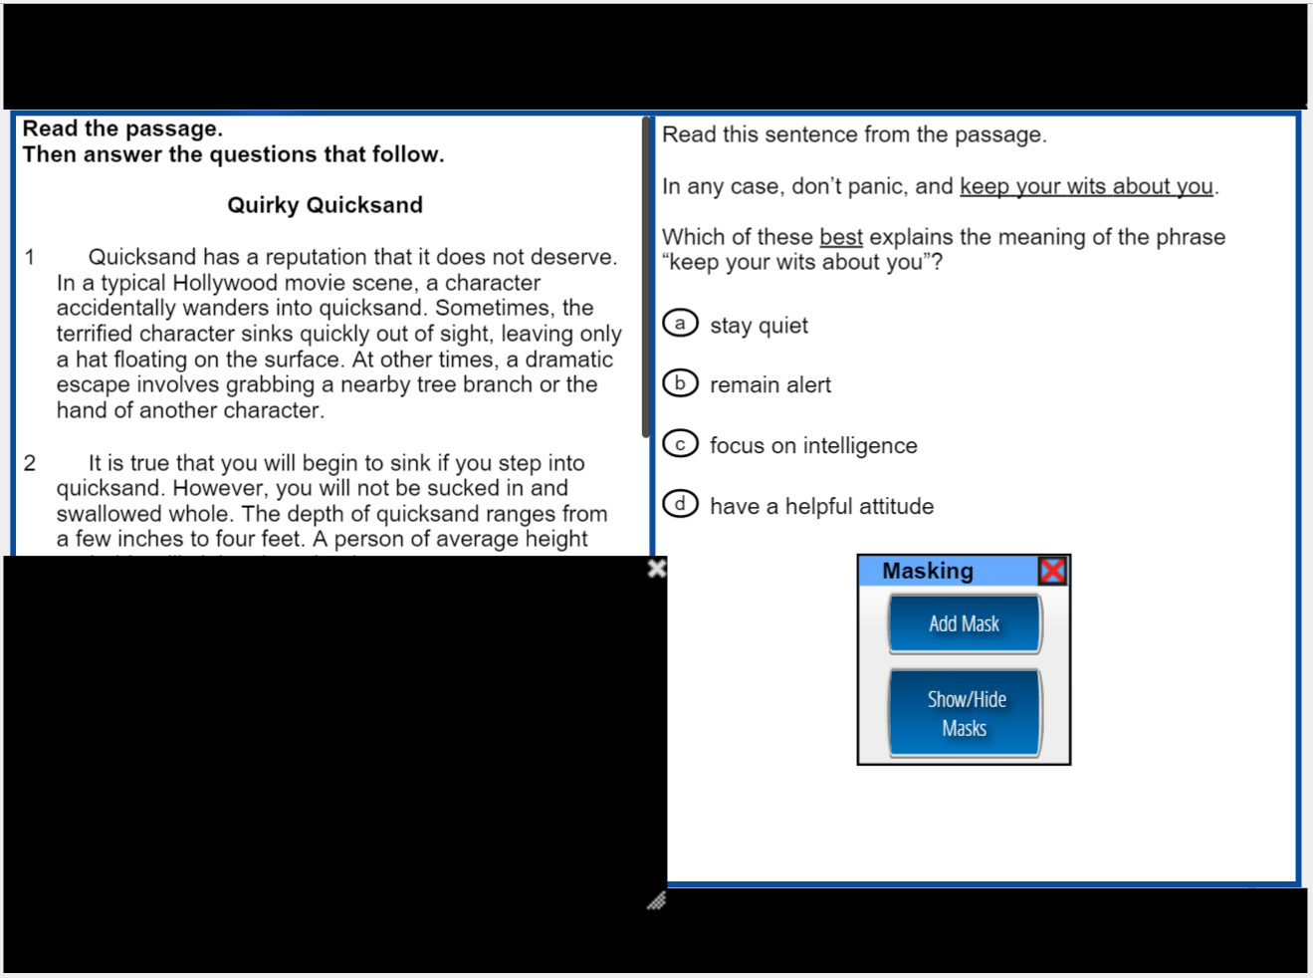
Masking
Original Item
Item with Masking
The test taker can place a mask over any portion of the screen. Multiple masks can be used simultaneously to customize the viewing area.

Slide 60
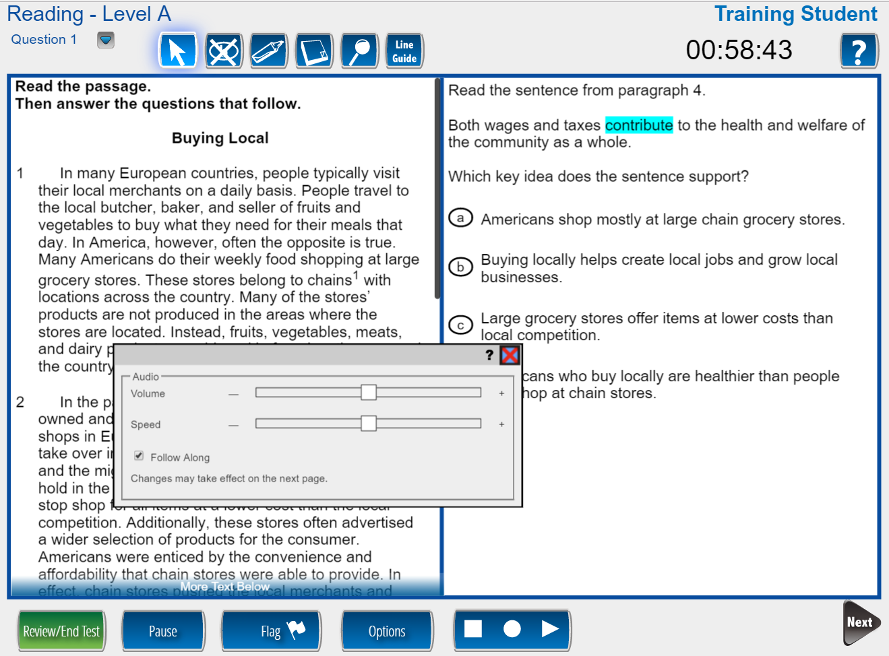
Text-to-Speech Audio
Follow Along highlighting of words as they are spoken
Audio settings for Volume, Speed, and Follow Along
Stop, Starting Points, and Play/Pause controls

Slide 61
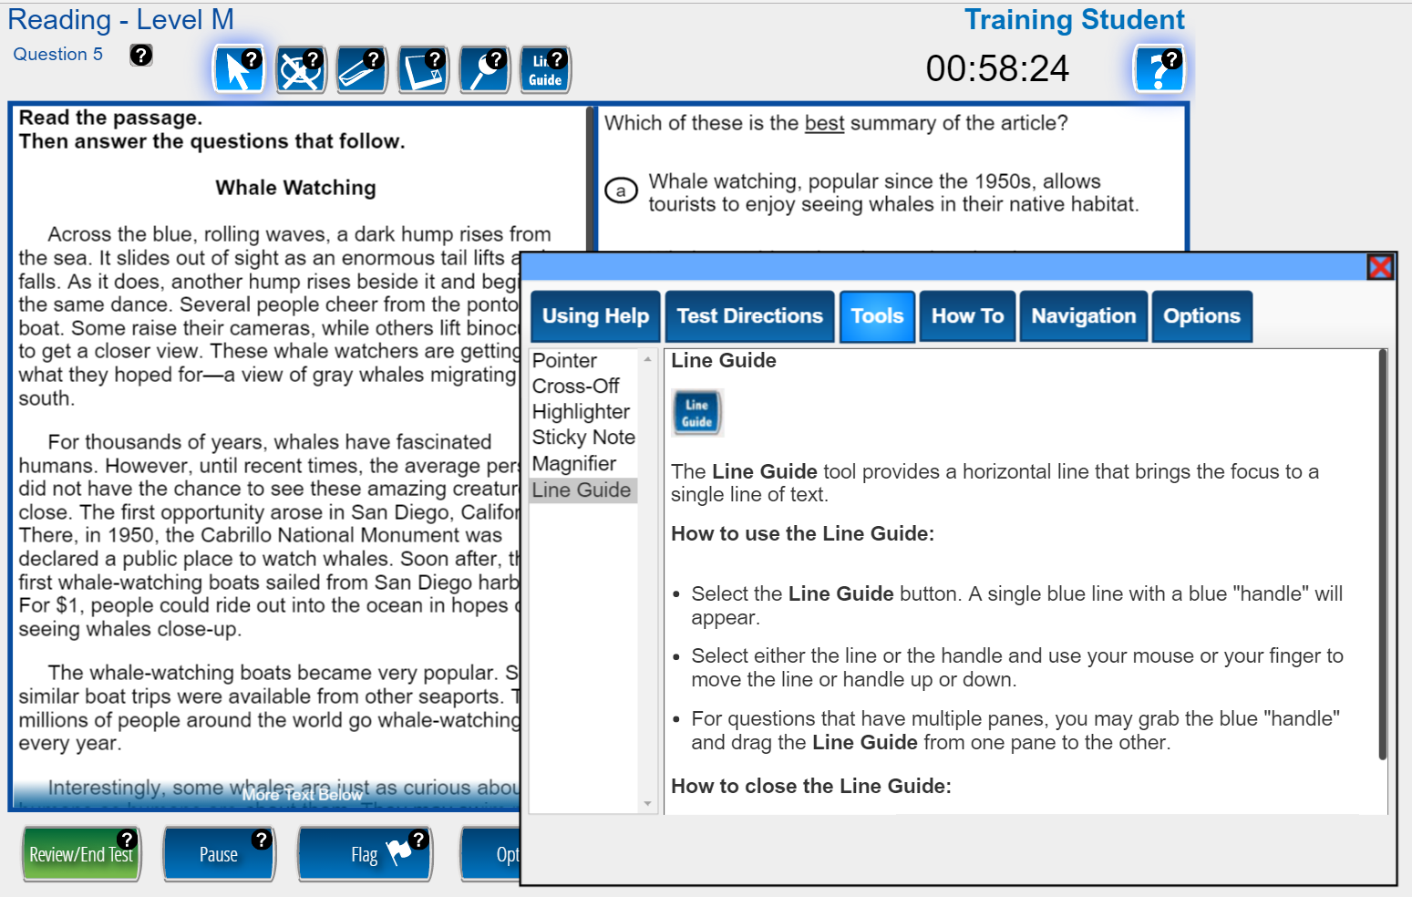
Context-Sensitive Help Screens
In Help mode, the test taker can click or tap on any object that has a question mark (e.g., Line Guide) to open contextual help for that object

Slide 62
Discussion Topics
  TABE Aligning to High School Equivalency
    Alignment (CCR standards) vs. predictions
  TABE Spanish
    Is it needed? Can Federal funds be used?
  TABE Instructional Alignments
    Aligning student performance to content
  TABE Career and Workforce Alignment
    Workforce-aligned report that ties TABE skills to workplace skills
  TABE Reporting Format
    Graphs, Charts
  TABE Technology
    Tablets
    Chromebooks

Slide 63
VI. TABE 11&12 Resources

Slide 64
TABE 11&12 Resources
  Now available on tabetest.com:
  TABE 11&12 Blueprints
  www.tabetest.com/resources-2/testing-information/blue-prints/
  TABE 11&12 Sample Practice Items
    www.tabetest.com/resources-2/testing-information/tabe-1112-practice/
  TABE 11&12 Online Tools Training
    www.tabetest.com/resources-2/testing-information/online-tools-training/

Slide 65
Thank You!
Mike Johnson
National Director
630-995-6712
mjohnson@datarecognitioncorp.com
Diana Levinson
Assessment Consultant- Michigan
317-389-0160
dlevinson@datarecognitioncorp.com

