Slide 1
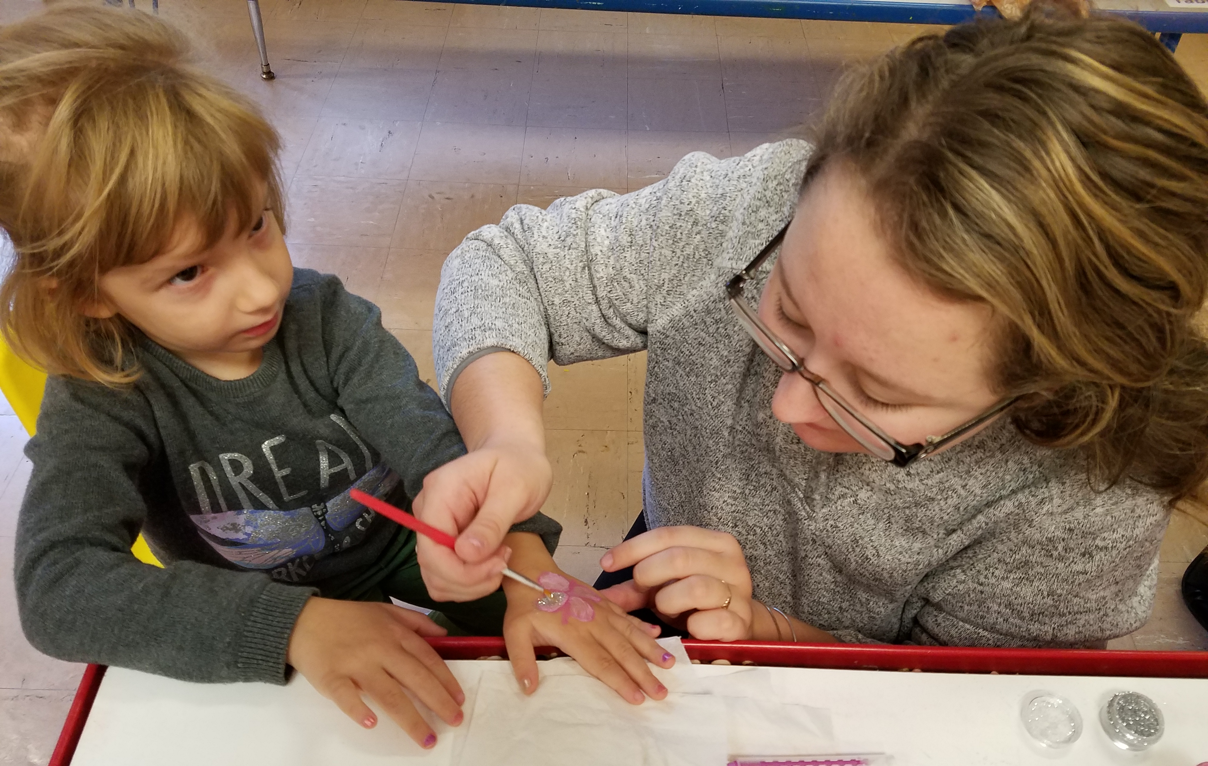
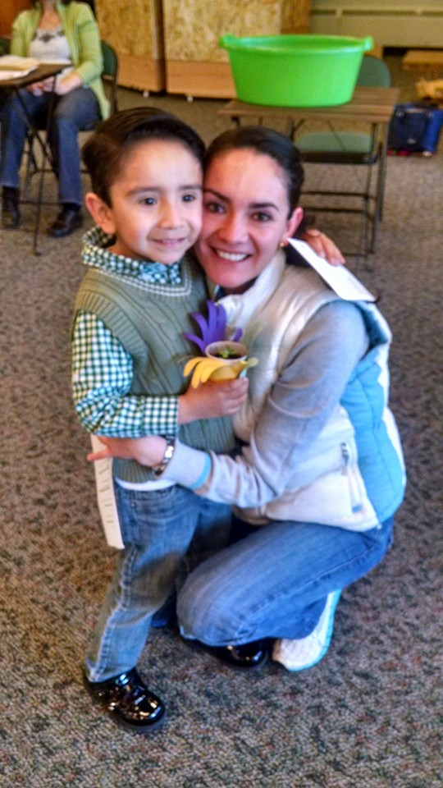

Family Literacy Night
MACAE Conference 2016
A+ English Language School

Slide 2

Why we wanted a Family Literacy Night:
Conduct parent surveys during registration
2015-16: 50% of our students with children and that number is growing.
2015-16: 50% of our families did not read to their children, go to the library, have a library card, or purchase books for their children.
Looking at the data, and knowing that federal language promotes Family Literacy, we decided to make a fun evening.

Slide 3

What is the need with our population:
Promote and practice English at home
Childcare Listings
Parenting Resources
Reading at home between parents and students
Conversations between parents and teachers
Improving School Readiness (International Preschool)
English language barrier

Slide 4

Michigan AND PROGRAM Data
Parents in Adult Education with Preschool Age Children: 6,056 (2015-16)
Parents in Adult Education with School-Age Children: 9,611 (2015-16)
In Michigan, 86.6% of children with immigrant parents are considered “English proficient” (Urban Institute)
Almost 60 percent of children whose parents lack a college education live in low-income families, and are less likely themselves to get a good education and secure family-sustaining jobs. (MACAE, 2016)
Intake Survey: Speak English at home, go to library, help child with homework, interact with child’s teacher (Okemos ESL)

Slide 5
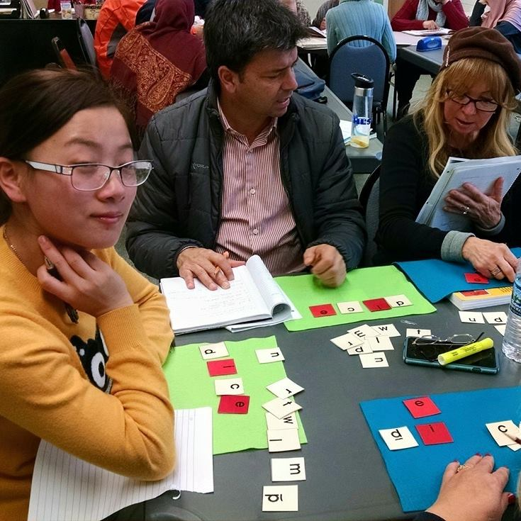
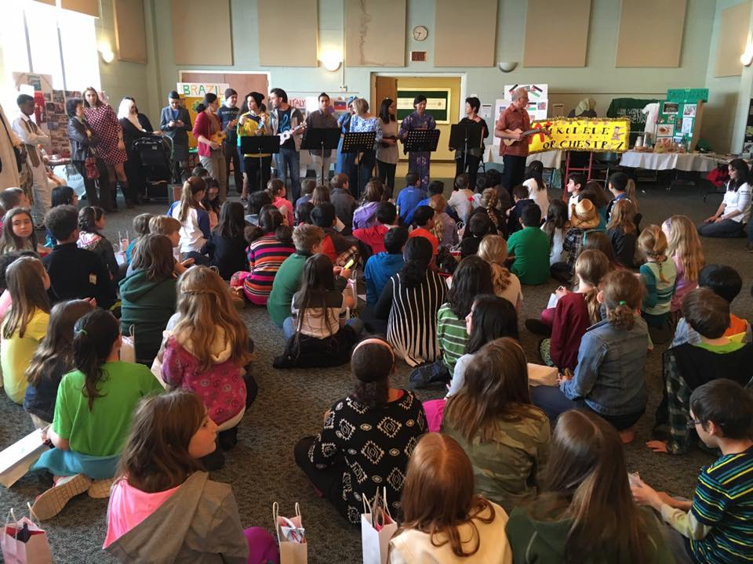
Goals
Establish the importance of family literacy with our staff and students
Demonstrate awareness of the importance of reading in early childhood development
Introduce a variety of activities for family literacy engagement
Give parents goals to measure child reading/academic growth
Increase reading fluency among adult ed students

Slide 6


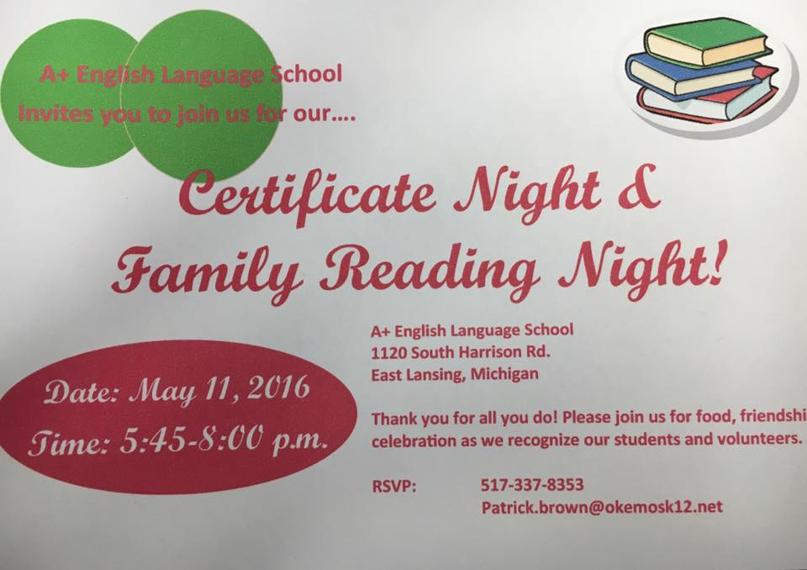

Program Invitees
We invited the following community partners:
Capital Area District Libraries (library cards, resources available, free books, etc.)
State Representative Singh
Community Volunteers for International Partnerships
Michigan State University
MSU A O II Sorority
“Celebrity” Readers!!!

Slide 7

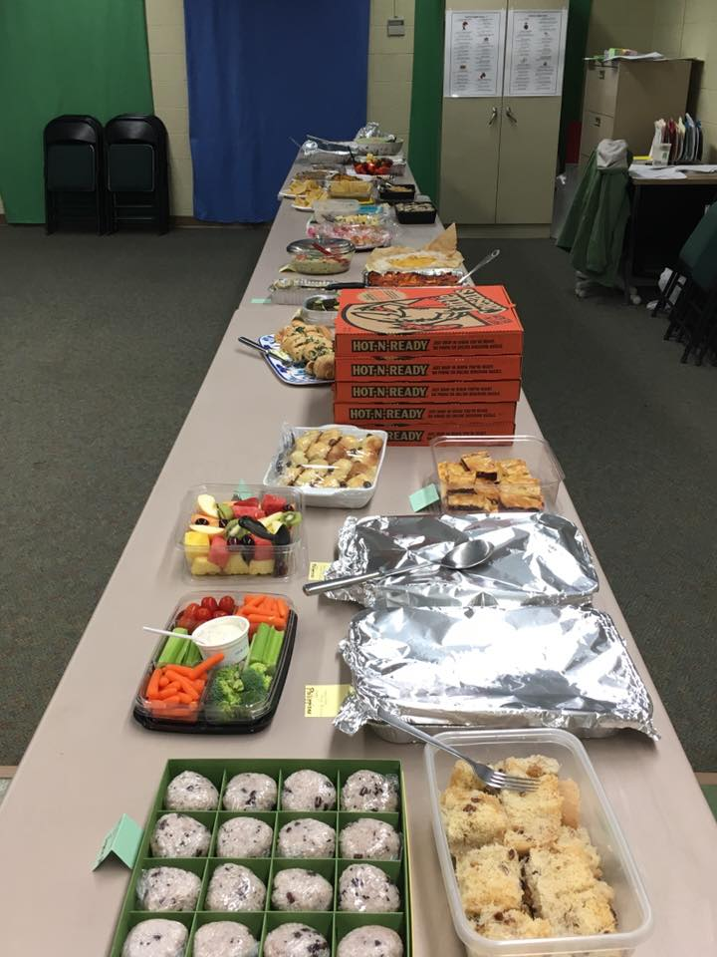
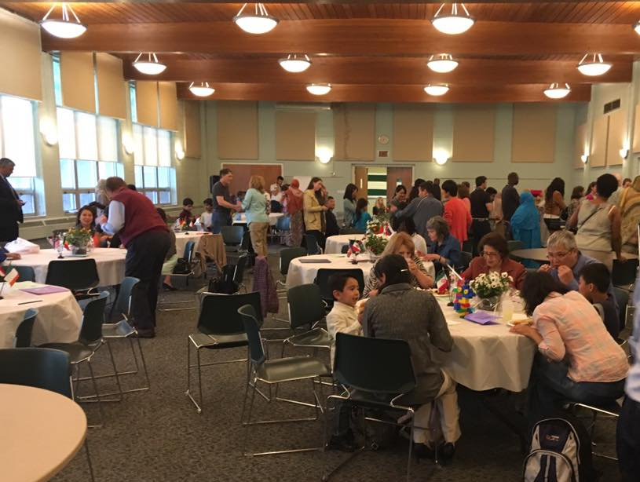
Preparation Check list
Generate Schedule of Events
Secure community partners
Coordinate food/assignment of responsibilities
Program materials (program announcement)
Handouts for parents (bookmarks, tips for helping children
at home, apps)
Advertisement of Event
Individual classroom activities

Slide 8
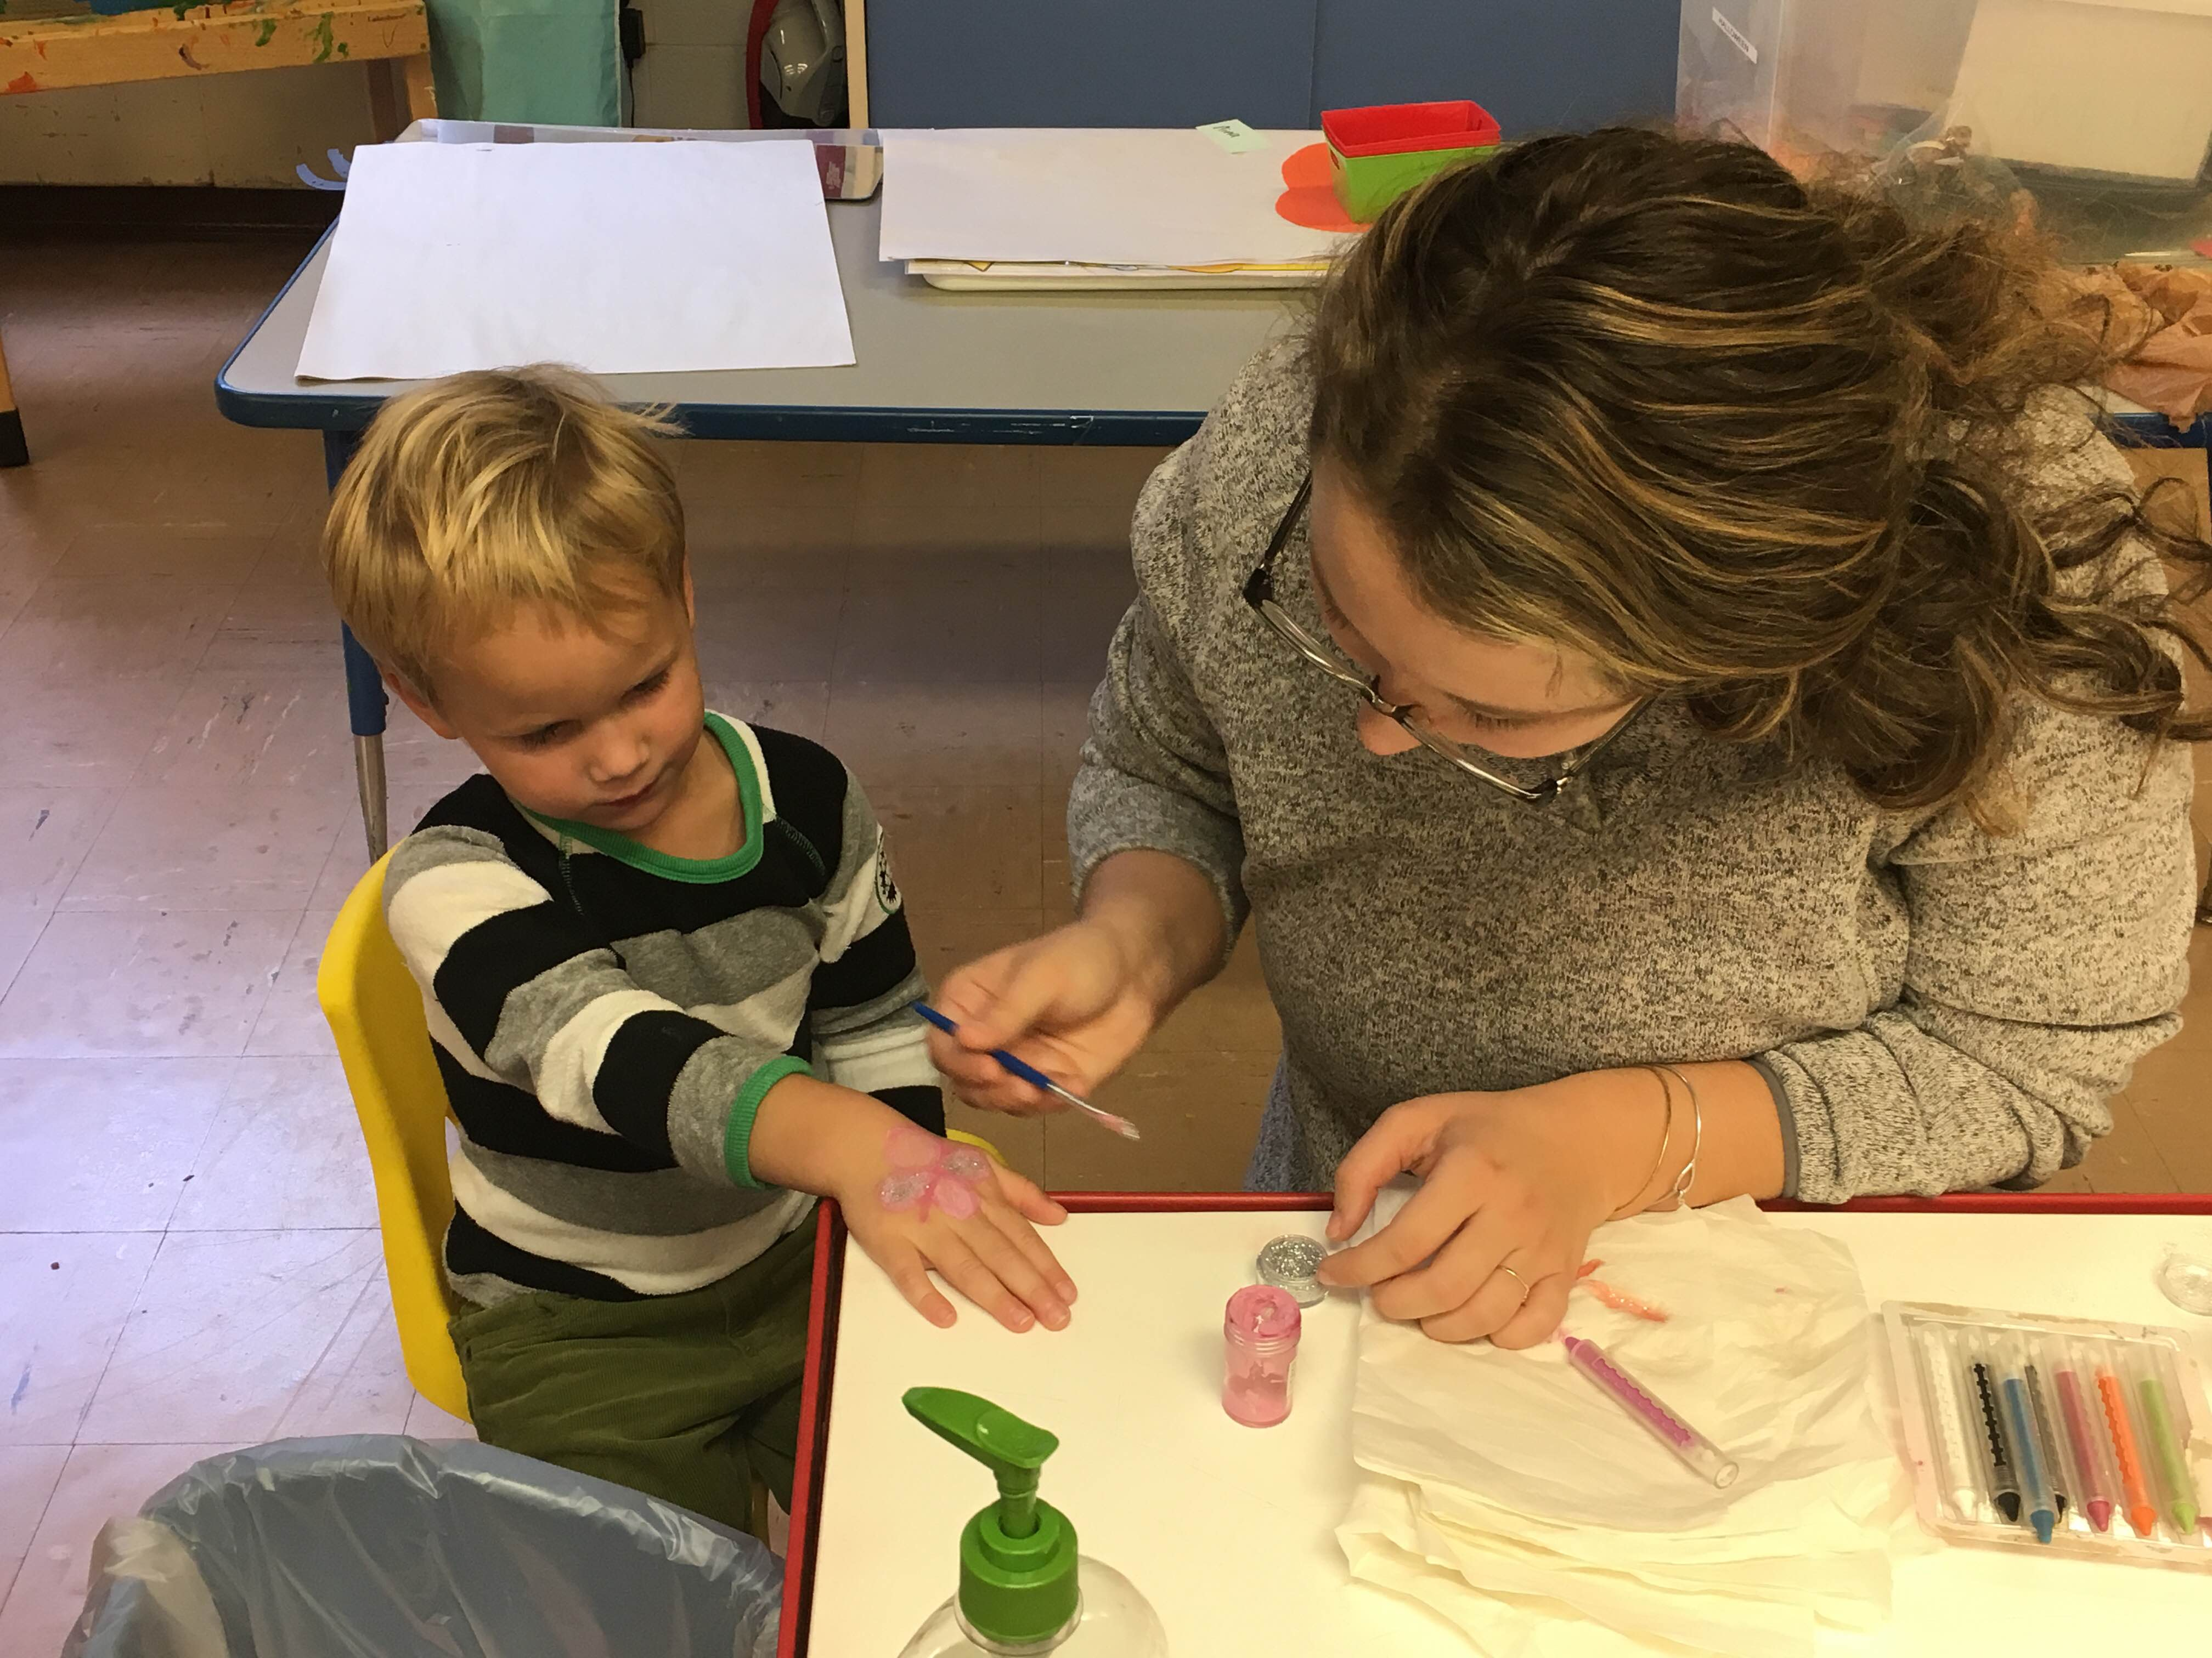
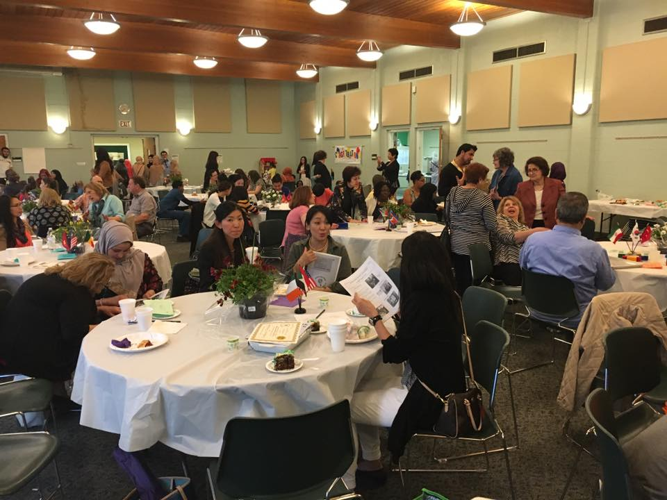
Program Activities!!
Certificate Night
Ages 0-12
Reading Room (“Celebrity” Readers)
Give aways (International Book Centre and Capital Area District Libraries gave free books); free popcorn from local movie theatre
Make a Book
Make a Bottle
Face Painting
Cake Walk
Ukulele Orchestra performance

Slide 9
Now It’s Your Turn!
Take a few moments to explore some of the activities you can do!

Slide 10
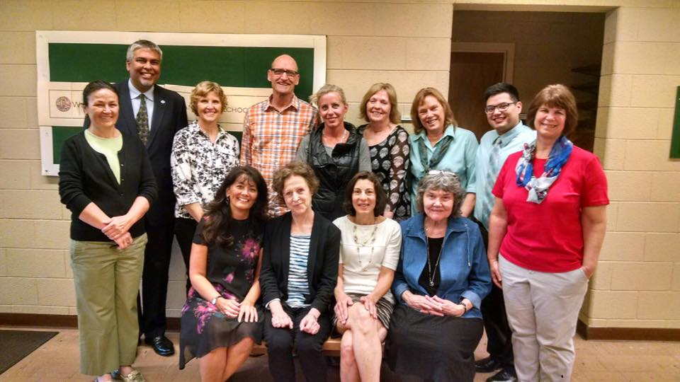
Wrap-Up
1)How might I use some of these resources in my program?
2)What is the first step in my action plan to start the planning process?

Slide 11
Contact Information
Karyn Goven
Director
A+ English Language School
karyngoven@gmail.com
Patrick Brown
Program Specialist
A+ English Language School
patrick.brown@okemosk12.net
A+ English Language School
Okemos Public Schools

