Slide 1
High-Quality Credentialing Under the Workforce Innovation and Opportunity Act (WIOA)
MACAE Spring Institute
May 19, 2017

Slide 3
What is an industry recognized credential?
Industry recognized credentials are sought or accepted by employers within the industry or sector involved, and are a recognized, preferred, or required credential for recruitment, screening, hiring, retention, or advancement purposes.

Slide 4
Defining Credentials
Under the Workforce Innovation and Opportunity Act (WIOA), the term “Recognized Postsecondary Credential” means a credential consisting of:
A certificate of completion of an apprenticeship;
A license recognized by the state involved or federal government; or
An associate or baccalaureate degree.
An industry recognized certificate or certification;

Slide 5
Credential Criteria
1. Industry Recognized | 2. Portable | 3. Third-Party Validated/Accredited | 4. Stackable
Either created or endorsed by industry, a nationally-recognized industry association or organization that represents a large portion of the industry with clear preference among local employers and regional training programs. A credential that is sought or accepted by companies within the industry for hiring or recruitment. | Recognized and accepted in settings other than in which it was earned: In other geographic locations At other educational institutions By other industries By other companies Recognized broadly, not only locally, among both employers and educational institutions, for the purposes of further education leading to additional advanced certificates. | Credentials are held to a higher standard of quality when they are accredited, for much the same reasons that the federal government requires third-party accreditation of colleges to be financial aid eligible. | A credential that is a part of a sequence of credentials that can be accumulated over time to build an individual’s qualifications and help them move along a career path to different and potentially higher-paying jobs. In the most basic sense, this refers to the career pathways concept that credentials should be linked, with lower-level content stacking to upper-level content, allowing an individual to earn further education and progress to higher paying jobs over time.

Slide 7
Ask Yourself
Is the program comprised of more than one course?
Program descriptions in college or training provider catalogues
Occupational licensing and certification requirements by the certifying agency

Slide 8
Ask Yourself
Lesson plan(s) and curriculum
Class syllabus
Prerequisites - i.e., the program is completed through a series of training activities that build upon each other to expand the student's breadth and depth of knowledge and skills
Evidence based on lesson plans, curricula, etc. that instructors typically teach the course in the same sequence, according to the same schedule, each time the course is offered
Does the training program have a clear structure and standardized mechanism of delivery?

Slide 9
Ask Yourself
Job qualifications or pre-requisites (e.g., licensure, certification or any other evidence the prospective employee must provide as evidence of competency in order to be hired)
Once all training and testing is completed, what does the student obtain for his/her effort? (e.g., license to practice, certificates of competency, eligibility for higher levels of training and education)
The individual can perform the work required by the occupation without additional training immediately after hiring (e.g., an emergency medical technician (EMT) can perform Cardiopulmonary Resuscitation (CPR) on a patient at the time of hiring by an ambulance service)
Does the program fulfill a specific set of occupational requirements with clear and measurable goals and objectives?
Will the credential holder be able to function effectively on the first day on the job/early in employment with minimal supervision?

Slide 10
Ask Yourself
Employer hiring standards within the industry
Evidence of reciprocity across state or regional borders (i.e., no further training is required to secure the same job in another location, or minimal training requirements to account for regulatory differences associated with state licensing and certification laws/regulations)
Are the skills transferrable?

Slide 11
Ask Yourself
Eligibility requirements for certificates, licenses or credentials
Continuing education requirements to renew certificates, licenses or credentials
Length of time a certificate, license or credential is valid
Recertification requirements after a certificate, license or credential has expired
Employer requirements for maintaining current certification, licensure or credentials
Employer pre-requisites to employment that state a preference for applicants with the certificate/credential
Is there evidence that the program provider will not award the credential should the participant fail to meet required standards?

Slide 12
Ask Yourself
How is successful program completion determined?
A written test must be passed to qualify for a license, certificate or credential
A practical skills test (if applicable) must be passed to qualify for a license, certificate or credential
The training program and courses have clearly stated pass-fail criteria that apply to all students

Slide 13
Ask Yourself
Who issues the certificate or license?
Is the issuing party listed in United States Department of Labor (USDOL) Training and Employment Guidance Letter (TEGL) 15-10?

Slide 14
Issuing Parties
A state educational agency or a state agency responsible for administering vocational and technical education within a state
A professional, industry, or employer organization (e.g., National Institute for Automotive Service Excellence certification or a National Institute for Metalworking Skills, Inc. Machining Level I credential) or a product manufacturer or developer (e.g., Microsoft Certified Database Administrator, Certified Novell Engineer, or a Sun Certified Java Programmer) using a valid and reliable assessment of an individual’s knowledge, skills and abilities
Employment and Training Administration’s Office of Apprenticeship or a State Apprenticeship Agency
Organizations and institutions that award industry recognized credentials include:
An institution of higher education described in Section 102 of the Higher Education Act that is qualified to participate in the student financial assistance programs authorized by Title IV of that Act (e.g., community colleges, proprietary schools, etc.)

Slide 15
Issuing Parties Continued
A public regulatory agency, upon an individual’s fulfillment of educational, work experience or skill requirements that are legally necessary for an individual to use an occupational or professional title or to practice an occupation or profession (e.g., Federal Aviation Administration aviation mechanic license or a state licensed asbestos inspector)
A program that has been approved by the Department of Veterans Affairs to offer education benefits to veterans and other eligible persons
Job Corps Centers that issue certificates
An institution of higher education which is formally controlled, or has been formally sanctioned or chartered, by the governing body of an Indian tribe or tribes
Organizations and institutions that award industry recognized credentials include:

Slide 16
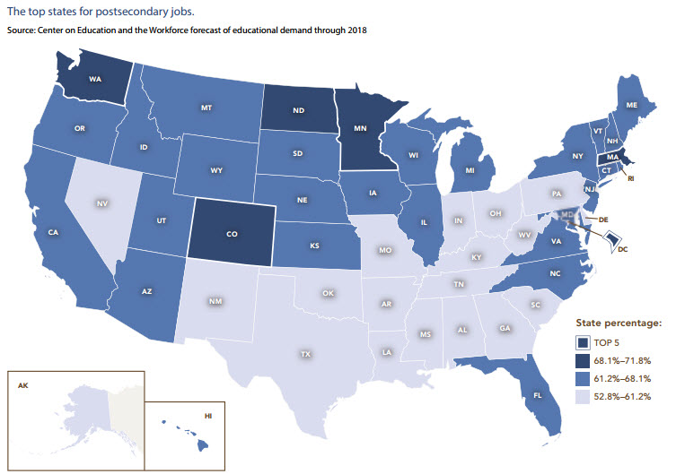
Why Credentials Matter
By 2018, over two-thirds of American jobs will require some postsecondary education or training, with nearly one-third of all jobs available to those with an associate’s degree.
Which states will lead the nation in job openings requiring postsecondary education?

Slide 17
Why Credentials Matter
Jobs requiring post-secondary education pay a significant premium over many jobs open to those with just a high school degree.

Slide 18
Begin challenging your own assumptions. Your assumptions are your windows on the world. Scrub them off every once in while, or the light won't come in. –Alan Alda
Higher Education Picture
Colleges and universities represent only 35 percent of the entire postsecondary education and training system.
The rest consists of on-the-job training, formal employer-provided education programs, military training, apprenticeships, and a variety of other programs.
https://cew.georgetown.edu/wp-content/uploads/2014/12/fullreport.pdf

Slide 19
National Dialogue
Growing Number & Type of Labor Market Credentials:
- Degrees - Diplomas
- Certifications - Licenses
- Apprenticeships
Growing Uncertainty About Meaning, Content, Quality, and Value:
- Competency/Credit Hour
- Prior Learning
- Multiple Schools
- Application/Academic
- Online
- Industry Recognized
Lack of Common Language for Describing/Comparing Credentials Confuses:
- Employers - Educators
- Students - Job Seekers
- Regulators - Certifiers
Misalignment & Inefficiencies:
- Misalignment of what industry says they
need, what educational opportunity
/training produces (outcomes), and what
the industrial credentialing organizations
test

Slide 20
State and Local Dialogue

Slide 21
Fast Facts
Click here to give it a try

Slide 22
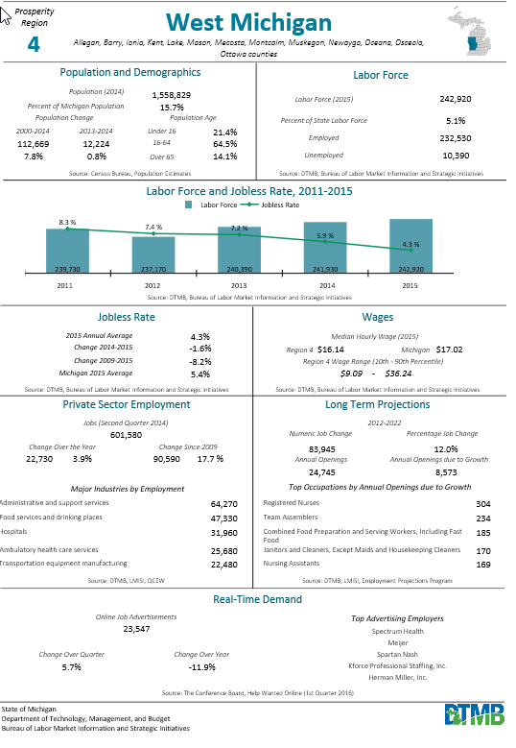
Highlight:
Regional
Fast Facts

Slide 23
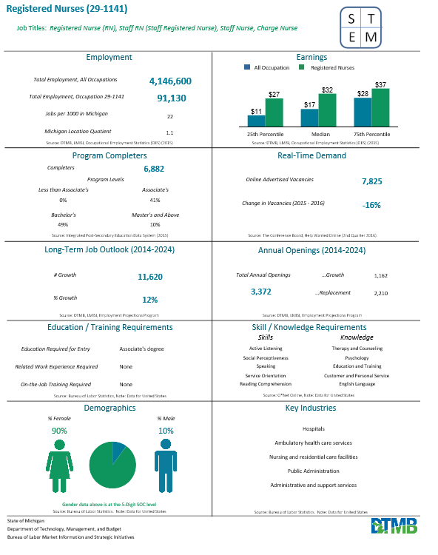
Highlight: Occupation Fast Facts

Slide 24
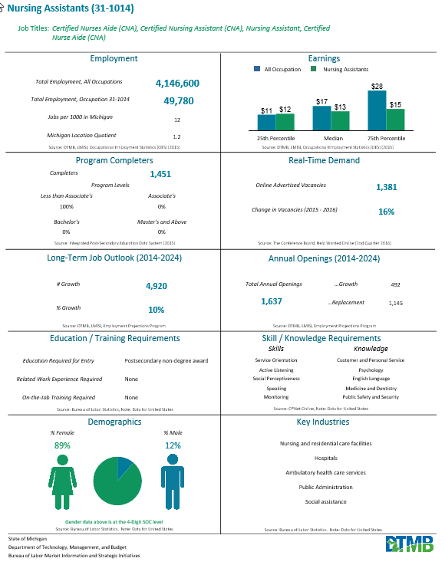
Career Path Option

Slide 25
Is the occupation suitable for the individual?

Slide 26
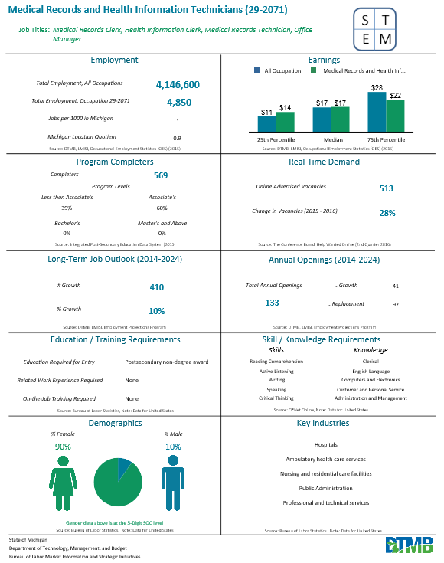
Plan B

Slide 27
Frequently Asked Questions
Q: May the National Career Readiness Certificate (NCRC) be reported as a credential?
A: No. Per the USDOL:
Training and Employment Guidance Letter 15-10 states work readiness certificates and Workforce Development Board issued certificates are not recognized as credentials. The USDOL considers the National Career Readiness Certificate (NCRC) to be work readiness and therefore it cannot be counted as a credential.

Slide 28
Frequently Asked Questions
Q: Does completion of On-the-Job Training (OJT) count as a credential?
A: Completion of an OJT does not automatically count as a credential. If; however, the individual receives an industry recognized certificate demonstrating attainment of technical or occupational skills as a result of the OJT, that certificate will count.

Slide 29
Frequently Asked Questions
Q: Does a Cardiopulmonary Resuscitation (CPR) certificate or Occupational Safety and Health Administration (OSHA) certificate count as a credential?
A: No. While CPR or OSHA training may provide benefit to participants as they begin to gain general knowledge about occupations and occupational standards, participants are unlikely to gain employment or advance within an occupation based solely upon receiving a CPR or OSHA certificate.

Slide 30
Frequently Asked Questions
Q: Does a ServSafe certificate count as a credential?
A: There are multiple certificates and certifications from ServSafe. The Food Handler certification does not meet the required USDOL criteria of a credential. Therefore, for those participants enrolled in WIOA, ServSafe Food Handler certificates may not be reported as credentials.
However, the ServSafe Food Protection Manager certification has been determined to meet the USDOL definition for a credential.

Slide 31
Frequently Asked Questions
Q: Does a National Retail Federation certification count as a credential?
A: Yes. Per USDOL correspondence, this certification is an acceptable credential.

Slide 32
Frequently Asked Questions
Q: Does completion of a Microsoft Word, Excel, or similar program count as a credential?
A: No. These single skill certificates do not count as credentials. However, completion of the Microsoft Office Suite is an acceptable credential.

Slide 33
Questions?
Krista Johnson
Adult Services Section Manager
Michigan Talent Investment Agency
johnsonk2@michigan.gov

