Slide 1
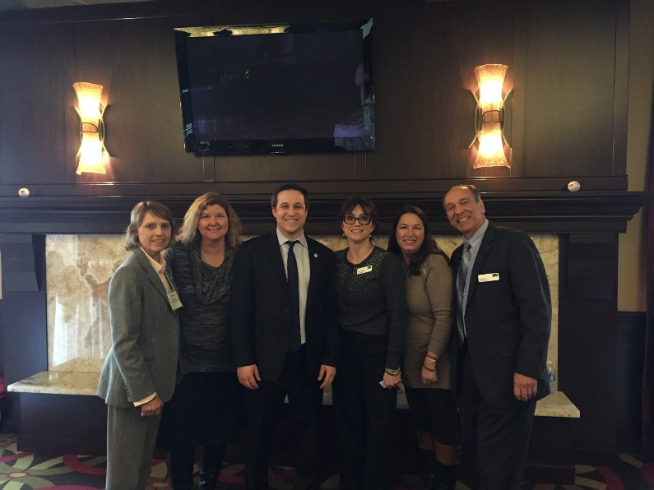
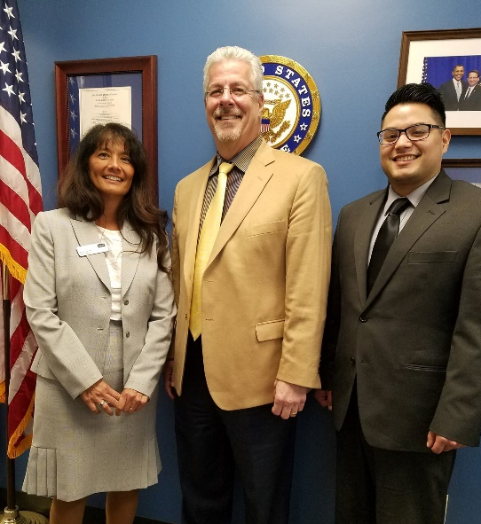
Advocating for Adult Ed: How To
Monday, October 15, 2018

Slide 2
Welcome
Introductions
Legislative Update
Adult Education Fact Sheet
Legislative Engagement Timeline
Marketing/Communications Update

Slide 3
Rate your level of comfort with engaging with your legislators
1 being uncomfortable, 5 being very comfortable
What are some of the challenges you see locally or regionally in engaging with legislators?

Slide 4
Legislative Update
Elections
Identifying partners in support of education
Key Education, Policy, and Workforce Committee Members

Slide 5
Student-Led Candidate Forums
Hosted by adult education providers
Students ask the questions

Slide 6
Candidate Forums
Monday, October 22 Kent ISD Candidate Forum 9:30am-11:00am
Contact: Oogie Lamar, oogielamar@kentisd.org
Wyoming Adult Education Site
(Media Center) 3600 Byron Center Ave., Wyoming, MI 49519
Tuesday, October 23 Novi Adult Ed Forum 5:30pm-7:00pm
Contact: Bob Steeh/Linda Cianferra, bob.steeh@novik12.org
Novi Middle School (Auditorium) 49000 W. Eleven Mile Road
Novi, MI 48374
Wednesday, October 24 LISD Tech Center/JC 5:30pm-7:00apm
Contact: Pam Gosla/Heather Robideaux, pgosla@mwse.org
Lenawee Intermediate School District Tech Center
1372 N. Main Street
Adrian, MI 49221
Tuesday, October 30
Zeeland-Holland Forum 10:00am-11:30am
Contact: Mike O’Connor, Director, moconnor@zps.org
Holland Mid Town Center 96 W. 15th Street
Holland, MI 49423

Slide 7
Adult Education Fact Sheet
What information might you include for your own program?
What specific issues or concerns are facing your students?
Which local media outlets could I connect with?

Slide 8
Marketing/Communications Update
5 in 5!!!
Assignment: Identify 2 of the 5 things you will tackle by the end of October!

Slide 9
Questions and Answers
Is there anything else you feel you need from us?

