Slide 1
MACAE Fall Conference 2019: Reaching Higher Awards Recognition Thursday, October 17, 2019

Slide 2
Program Advocate

Slide 3
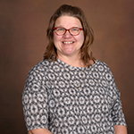
Program Advocate
Brenda Baker
Fruitport Adult and Alternative Education

Slide 4
Support Staff

Slide 5
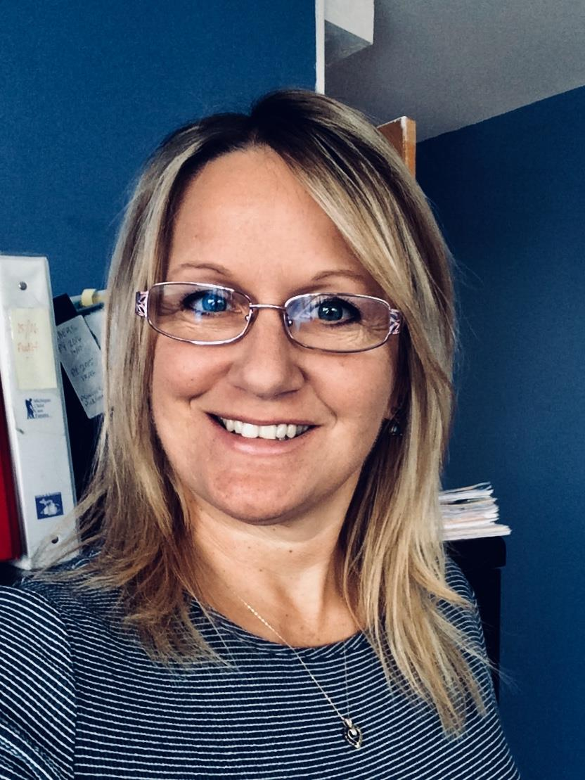
Support Staff Michelle VanSloten
Consolidated Community School Services

Slide 6
Outstanding Educator

Slide 7
Outstanding Educator
Candace Clayton
Kalamazoo Public Schools Adult Education

Slide 8
Outstanding Educator

Slide 9
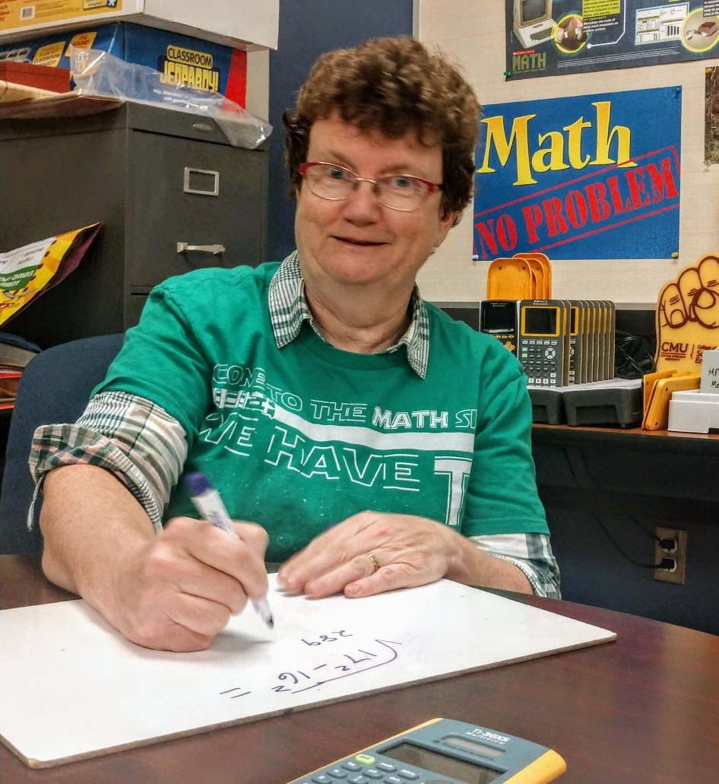
Outstanding Educator
Patricia Heitman
Mt. Pleasant Community Education

Slide 10
Trail Blazer

Slide 11
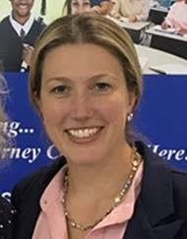
Trail Blazer
Katie Thompson
Integrated Education and Training Coordinator,
Troy Continuing Education

Slide 12
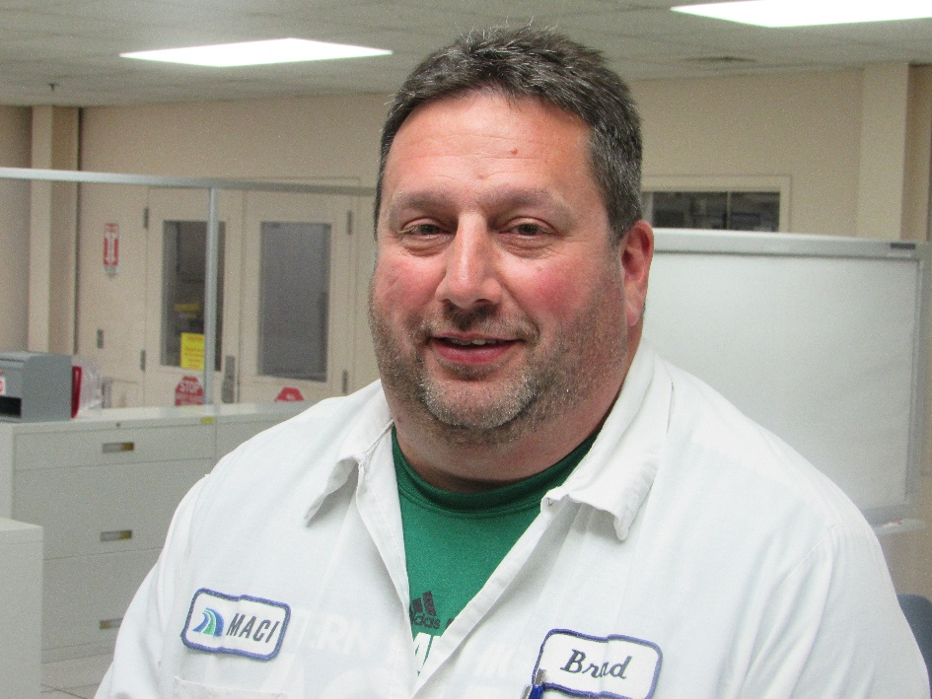
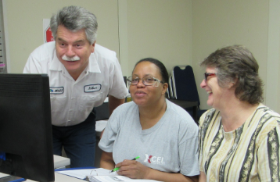
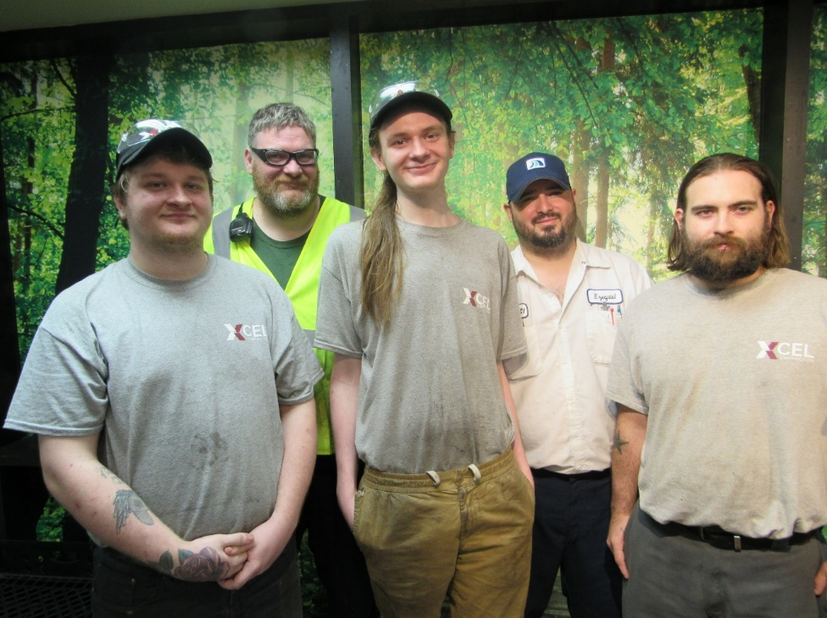
Trail Blazer
Michigan Automotive Compressor, Inc.

Slide 13
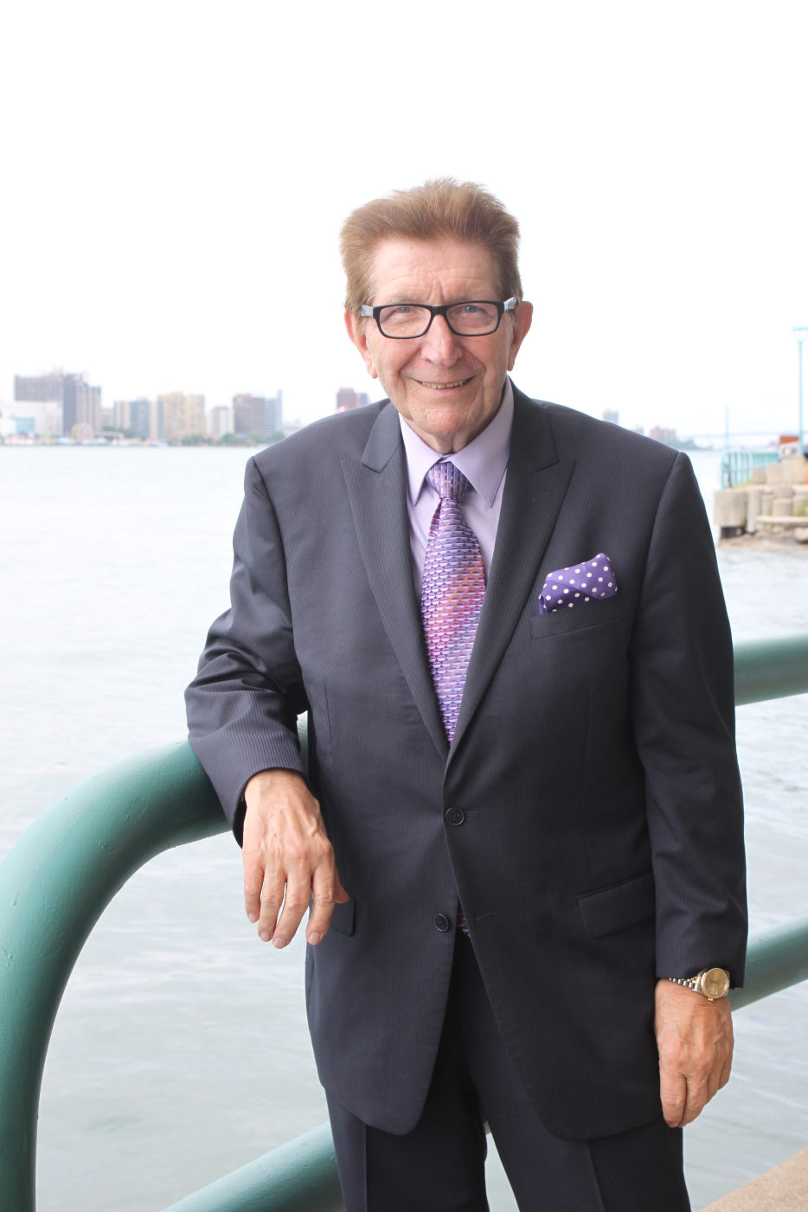
Lifetime Achievement Award
Howard Weaver

Slide 14
MACAE Fall Conference 2019: Reaching Higher Awards Recognition

