Slide 1
Charting the Path to Career Success
The Professional Achievement Scorecard
Presented by Pam Gosla & Heather Robidoux

Slide 2
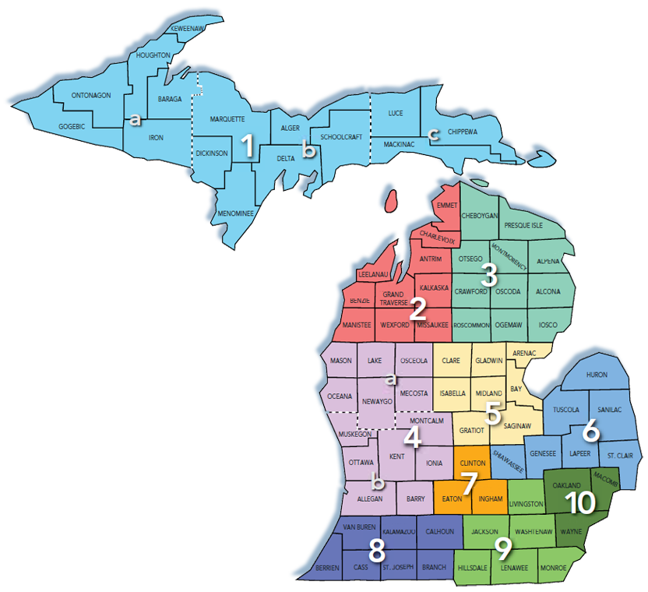
Introductions
Who are you? Where are you from?

Slide 3
Intended Objectives
Explain the relationship between Adult Education (AE) & Workforce Development (WD)
Identify how this interrelationship impacts AE programming
Identify strategies to help AE fill in the gaps in career readiness & employability skills
Create the best outcomes? Address this call to action? How can adult education impact career choice? Before contextualization begins, choice happens. How to know if the choice is the right choice.

Slide 4
Group Discussion
Consider the following questions:
How do you currently address WD issues in the AE classroom?
What is the real purpose of AE?

Slide 5
The AE Mandate
The purpose of AE is to prepare the workforce
AE is funded through the Workforce Innovation and Opportunity Act (WIOA) NOT the Department of Education
AE measures performance using WIOA metrics
The ultimate goal of AE is sustainable employment

Slide 6
The Department of Labor and Economic Opportunity
Director
MEDC
WD
UIA
MSHDA
Chief of Staff
State Land Bank
WIOA (Title I Adult & Title II)
State School Aid Section 107
GED-to School Program
Wagner-Peyser Employment Services
Reemployment Services & Eligibility Assessment (RESEA)
Work-Based Training for Special Populations
Fidelity Bonding

Slide 7
The Obstacles
AE requires formally trained educators
Difficult for AE to see the perspective of WD
Internal conflict between academic growth versus current employment opportunities
Time consuming to adjust content & instruction
Just plain frustrating

Slide 8
Our Challenge
How can AE address this call to action & create the best outcomes for participants, our programs, & the workforce?
How can AE impact academic achievement while simultaneously impacting career decisions, outcomes, and longevity?

Slide 9
Seek Balance
How will AE assist participants to address immediate needs while still considering their long-term goals?
Immediate Need
Future Aspirations
Employment
Education
Basic Necessities

Slide 10
Our Initial Response
We wanted to ensure that participants were making informed career decisions
We began utilizing Kuder Journey
Participants selected careers choices based on their interests, skills, & work values
We contextualized learning & began working with participants individually to help them along their career path
Notes:
When thinking about really incorporating career development strategically into our program, we realized that before contextualization begins, choice happens. How to know if the choice is the right choice. How do students really decide what they want to do?
We were familiar with idea of career exploration and the tool K12 tool Career Cruising, but needed to find something on an adult level

Slide 11
Observations
The participants who were most successful in meeting career goals were:
Self-aware
Knowledgeable about career options
Familiar with goal setting
Engaging in skills development
Able to interact well in a professional setting
Notes:
We were familiar with idea of career exploration and the tool K12 tool Career Cruising, but needed to find something on an adult level

Slide 12
Observations
The Kuder Journey was helpful, but we needed to go much more in depth
Contextualization mattered, but only if the chosen career had been adequately vetted
Even then, we needed a better approach to address those other crucial career readiness skills

Slide 13
Considerations
Local K12 districts & postsecondary institutions had been in the process of developing credentials to indicate career readiness
We needed to find a way to allow our AE population the same opportunity

Slide 14
Career Readiness Quadrants
Explore
Finding My Career
Prepare
Preparing Myself
Engage
Relating to Others
Launch
Entering the Professional World
Prepare
Engage
Launch
Explore
Notes:
Through all 4 components the AE /WD components are intertwined

Slide 15
Career Path
We connected with a developer working on a system that aligned well with our ideas
Career Path was already making a name for themselves in the postsecondary setting
We collaborated to adjust the content to meet the needs of the AE population
Resulting in our Professional Achievement Scorecard (PAS)
Notes:
Explain name choice & marketing potential

Slide 16
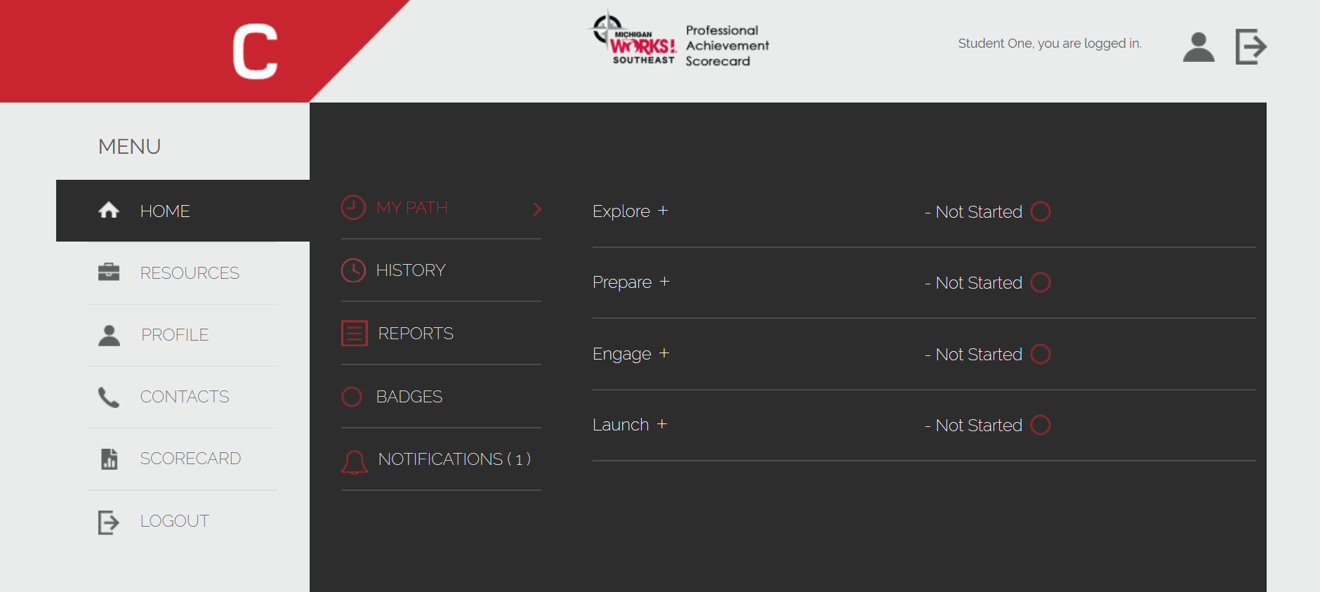
Student Experience Demo

Slide 17
PAS Highlights
Internet-based tracking system
Assign activities & monitor progress
Computer-based & app versions available on any device
Badging system resulting in a certificate endorsed by Michigan Works! Southeast
Administration can run reports & send notifications to participants

Slide 18
PAS Highlights
Short, doable activities & immediate successes
Ability to easily incorporate academic skills with the career readiness activities
Lessons build upon each other in a linear fashion
Connects participants to additional resources
Lifetime access for individual participants
Participants can return to the process at anytime

Slide 19
Pilot Program
Currently running a pilot program with two AE providers across several counties
Employers buying into the fact that they can see something concrete to indicate career readiness
Both K12 & postsecondary institutions agree that PAS takes their work to the next level
We are working collaboratively to set the standard for career readiness

Slide 20
Group Discussion
Consider the following questions:
What are your thoughts about the PAS?
What do you want to know more about?

Slide 21
Questions?
Pam Gosla
Research & Education Manager
517-437-3381 ext., 65221
pgosla@mwse.org
Heather Robidoux
Adult Education Program Supervisor
(517)437-3381 ext. 65222
hrobidoux@mwse.org

